Slide 1
Reliable and Scalable Checkpointing Systems for Distributed Computing Environments
Final exam of
Tanzima Zerin Islam
School of Electrical & Computer Engineering
Purdue University
West Lafayette, IN
Date: April 8, 2013

Slide 2





Distributed Computing Environments
High Performance Computing (HPC):
  Projected MTBF 3-26 minutes in exascale
  Failure: hardware, software
Grid:
  Cycle sharing system
  Highly volatile environment
  Failure: eviction of guest jobs
@Notre Dame
@Purdue
@Indiana U.
Internet

Slide 3
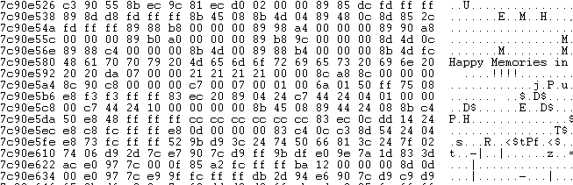
Fault-tolerance with Checkpoint-Restart
Checkpoints are execution states
System-level
  Memory state
  Compressible
Application-level
  Selected variables
  Hard to compress
Struct ToyGrp{
1. float Temperature[1024];
2. int Pressure[20][30];
};
Notes:
One of the most widely used paradyme in providing reliability is checkpoint/restart.

Slide 4
Challenges in Checkpointing Systems
HPC:
  Scalability of checkpointing systems
Grid:
  Use of dedicated checkpoint servers
@Notre Dame
@Purdue
@Indiana U.
Internet

Slide 5
Contributions of This Thesis
2nd Place, ACM Student Research Competition’10
Compression on Multi-core
FALCON
mcrEngine
Scalable Checkpointing System in HPC
[Best Student Paper Nomination, SC’12]
mcrCluster
Reliable Checkpointing System in Grid
[Best Student Paper Nomination, SC’09]
Unpublished
Prelim
2007 - 2009
2009-2010
2010-2012
2012-2013

Slide 6
Agenda
[mcrEngine] Scalable checkpointing system for HPC
[mcrCluster] Benefit-aware clustering
Future directions

Slide 7
A Scalable Checkpointing System using Data-Aware Aggregation and Compression
Collaborators:
Kathryn Mohror, Adam Moody, Bronis de Supinski

Slide 8
Big Picture of HPC
Compute Nodes
Network Contention
Gateway Nodes
Contention for Shared File System Resources
Atlas
Contention for Other Clusters
Hera
Hera
Parallel File System

Slide 9
Checkpointing in HPC
MPI applications
  Take globally coordinated checkpoints asynchronously
Application-level checkpoint
High-level data format for portability
  HDF5, Adios, netCDF etc.
Checkpoint writing
Struct ToyGrp{
1. float Temperature[1024];
2. short Pressure[20][30];
};
HDF5 checkpoint{
Group “/”{
Group “ToyGrp”{
  DATASET “Temperature”{
  DATATYPE H5T_IEEE_F32LE
  DATASPACE SIMPLE {(1024) / (1024)}
  }
  DATASET “Pressure” {
  DATATYPE H5T_STD_U8LE
  DATASPACE SIMPLE {(20,30) / (20,30)}
  }}}}
N➔1 (Funneled)
N➔M (Grouped)
N➔N (Direct)
Application
Parallel File
System (PFS)
Parallel File
System (PFS)
Parallel File
System (PFS)
I/O Library
Data-Format API
HDF5
NetCDF
Not scalable
Best compromise
but complex
Easiest but
contention on PFS
Notes:
As we move forward towards exascale, mean time between failures is decreasing from order of hours to order of minutes.
-- Checkpoint/restart has been widely used in these environments to provide fault-tolerance.
MPI applications running on clusters take globally coordinated checkpoints -- meaning all the processes collaborate together to decide when to take a checkpoint.
3. In an application-level checkpoint, a process decides which variables to store as opposed to simply copying the entire memory state.
4. To enhance portability of these checkpoints across multiple-architectures, many applications use high-level data formats
such as HDF5 to annotate variables with meta-data information.
-- For example, an HDF5 annotation will have variable name, data type etc. along with data.
5. Once processes take checkpoint, applications transfer them to Parallel File System or PFS in one of three different ways.
(5.1) In one extreme, N->1 where 1 process gathers checkpoints from all others, and write to the PFS. It will not scale because 1 process is the bottleneck.
(5.2) In another extreme is N-> N or direct, easiest to implement but increases contention on PFS at large scale.
(5.3) N->M is the best compromise where groups of processes aggregate their checkpoints and send to the PFS.
--However, it increases complexity of application code.

Slide 10

Impact of Load on PFS at Large Scale
IOR
  Direct (N➔N): 78MB per process
Observations:
  (−) Large average write time less frequent checkpointing
  (−) Large average read time poor application performance
Average Write Time (s)
Average Read Time (s)
# of Processes (N)
Notes:
To study the impact of growing scale of applications, we used a file system benchmark IOR (Interleaved-or-random Filesystem benchmark)
on Livermore’s Lustre filesystem.
To emulate direct transfer approach
(2) X axis shows the number of processes concurrently transferring data, and Y axis shows the average operation times.
(3) Each process sends 78MB of data
(4) The first observation is: avg ckpt write time inreases at large scale
-- this reduces checkpointing frequency and as a result means loss of more computation when a failure occurs.
(5) The second observation is that performance impact is even worse during ckpt reading time
-- Since checkpoint reading happnes in the critical path of an application, high reading overhead impacts application performance negatively.

Slide 11
What is the Problem?
Today’s checkpoint-restart systems will not scale
  Increasing number of concurrent transfers
  Increasing volume of checkpoint data
Notes:
(1) So what is the problem?
(2) As MPI applications are growing to 100s of thousands of processes, today’s checkpoint-restart systems will not scale due to two reasons
(3) As we saw in the previous slide, due to increasing number of concurrent transfers
-- why? causing contention on PFS
(4) and increasing volume of checkpoint data per application.

Slide 12
Our Contributions
Data-aware aggregation
  Reduces the number of concurrent transfers
  Improves compressibility of checkpoints by using semantic information
Data-aware compression
  Improves compression ratio by 115% compared to concatenation and general-purpose compression
Design and develop mcrEngine
  Grouped (N➔M) checkpointing system
  Improves checkpointing frequency
  Improves application performance
Notes:
(1) To solve these two problems, we propose a novel data-aware aggregation scheme that not only reduces the number of concurrent transfers, but also improves compressiblity of checkpoints, by bringing together data that are semantically similar across processes
(2) And then, apply data-aware compression that yields better compression than simply concatenating checkpoints and compressing
(3) Then, we designed and developed an N->M checkpointing system mcrEngine, that decouples checkpoint transfer from applications. So now, application processes can simply take their checkpoint and resume work without having to worry about how to transfer them to the PFs.
(4) mcrEngine also improves application performance by reducing restart overhead.

Slide 13
Naïve Solution: Data-Agnostic Compression
Agnostic scheme – concatenate checkpoints
Agnostic-block scheme – interleave fixed-size blocks
Observations:
  (+) Easy
  (−) Low compression ratio
C₁
First Phase
C₁
C₂
PFS
pGzip
C₂
C₁
[1-B]
C₁
[B+1-2B]
C₁
[1-B]
C₂
[1-B]
C₁
[B+1-2B]
C₂
[B+1-2B]
PFS
pGzip
C₂
[1-B]
C₂
[B+1-2B]
Notes:
(1) The most intuitive way of aggregating these checkpoints is data-agnostic., meaning not looking at the data written in them.
(2) We can simply concatenate them one after another, and then compress. A scheme we call Agnostic
(3) Or, interleave checkpoints in blocks and then compress. This is what we call Agnostic-block scheme.
(5) It is certainly very easy to implement, however, does not yield good compression, even if we apply another level of compression after the first phase.

Slide 14
Our Solution: [Step 1] Identify Similar Variables Across Processes
[Step 2] Merging Scheme I: Aware Scheme
[Step 2] Merging Scheme II: Aware-Block Scheme
P₀
P1
Meta-data:
Name
Data-type
Class:
  -- Array, Atomic
Group ToyGrp{
float Temperature[1024];
int Pressure[20][30];
};
Group ToyGrp{
float Temperature[100];
int Pressure[10][50];
};
C₁.T
C₁.P
C₂.T
C₂.P
Concatenating similar variables
C₁.T
C₂.T
C₁.P
C₂.P
C_{1.}T
C_{1.}P
C_{2.}T
C_{2.}P
Interleaving similar variables
First ‘B’ bytes of Temperature
Next ‘B’ bytes of Temperature
Interleave
Pressure
Notes:
(1) And the other way is to look at the actual data and put similar variables together.
(2) The rationale is that putting similar data closel result in better compression than mixing up different types of data.
(2) We use variable names, data-type and class information to find similar variables. I/O libraries such as HDF5 or netCDF, already make these information available.
(3) To merge these,
(3.1) we can either concatenate similar variables one after another. This is what we can aware scheme

Slide 15
[Step 3] Data-Aware Aggregation & Compression
Aware scheme – concatenate similar variables
Aware-block scheme – interleave similar variables
C₁.T
C₁.H
C₂.T
C₂.H
C₁.P
C₁.D
C₂.P
C₂.D
Data-type aware compression
FPC
Lempel-Ziv
First Phase
Output buffer
T
P
H
D
pGzip
Second Phase
PFS
Notes:
(1) Once we merge similar variables, we apply data-type specific compression.
(2) For example we use Burtscher’s FPC algorithm for double precision floating point data and lempel-ziv for integers.
-- Our reason for using data-type specific compression for the first phase is, that prior work has shown that general purpose algorithms do not work well with non-uniform datatypes such as floats, which are very common in scientific datasets.
(3) Then, we buffer these merged-compressed chunks.
(4) Once we are done with all the vairables or the output buffer is full, we apply Gzip and write final output to the PFS.
(5) We actually find that the 2nd phase makes a big difference in compression ratio.

Slide 16
How mcrEngine Works
CNC : Compute node component
ANC: Aggregator node component
Rank-order groups, Grouped (N➔M) transfer
CNC
Identifies “similar” variables
CNC
Applies data-aware aggregation and compression
CNC
Compute
Component
Request T, P
Aggregator
Request H, D
Meta-data
T
H
P
Group
D
T
P
H
D
pGzip
CNC
CNC
Group
CNC
PFS
Compute
Component
Request H, D
Aggregator
Request T, P
Meta-data
T
H
P
D
T
P
H
D
CNC
pGzip
CNC
Group
CNC
Compute Component
T
Aggregator
H
P
D
Request H, D
Meta-data
Request T, P
T
P
H
D
pGzip
Notes:
(1) This is the big picture of how different components of mcrEngine works.
(2) mcrEngine has a compute node component that is a daemon process that runs where the application is running.
(2) And, aggregator node component that can either run on I/O nodes or on another compute node
(3) First, groups of compute nodes send meta-data to their respective aggregatorsidentifies similar variables across all checkpoints in the same group
-- 2. Requests data for a bunch of variables, applies data-aware aggregation and compression, requests for some more variables and so on.
-- 3. Once done will all variables, it applies gzip and sends final output to the PFS
(4) Two things to note:
-- This pull based design of mcrEngine ensures that disk space on Aggregators will not be overwhelmed.
--Also, variable reading, compression and buffering to local disk on aggregators happen in parallel.

Slide 17
Evaluation
Applications
  ALE3D – 4.8GB per checkpoint set
  Cactus – 2.41GB per checkpoint set
  Cosmology – 1.1GB per checkpoint set
  Implosion – 13MB per checkpoint set
Experimental test-bed
  LLNL’s Sierra: 261.3 TFLOP/s, Linux cluster
  23,328 cores, 1.3 Petabyte Lustre file system
Compression algorithm
  FPC [1] for double-precision float
  Fpzip [2] for single-precision float
  Lempel-Ziv for all other data-types
  pGzip for general-purpose compression
Notes:
(1) To evaluate our techniques and the performance of our system, we used different ranges of checkpoint sizes from 4 real applications.
(2) ALE3D and cactus have the largest set of checkpoints, and Cosmology and Implosion have the smaller ones.
(3) We ran our experiments on Livermore’s production linux cluster Sierra with 15,409 cores.
(4) For data-type specific compression, we used FPC, fpzip and lz. And for general purpose compresion used gzip. We actually compared performance of gzip with bzip2 and XY and found that gzip strikes the right balance between compression time and compression ratio.

Slide 18
Evaluation Metrics
Effectiveness of data-aware compression
  What is the benefit of multiple compression phases?
  How does group size affect compression ratio?
Performance of mcrEngine
  Overhead of the checkpointing phase
  Overhead of the restart phase
Uncompressed size
Compression ratio =
Compressed size
Notes:
(1) We first evaluate how well data-type aware compression works by measuring compressio ratio. We study the benefit of multiple passes compression, impact of group size and change in compression ratio with time.
(2) Then, we measure the performance of checkpointing and restart phases of mcrEngine.

Slide 19
No Benefit with Data-Agnostic Double Compression
Multiple Phases of Data-Aware Compression
are Beneficial
Data-agnostic double compression is not beneficial
  Because, data-format is non-uniform and uncompressible
Data-type aware compression improves compressibility
  First phase changes underlying data format
Data-Agnostic
Compression Ratio
Data-Aware
Notes:
(1) First, we investigate the benefit of two phases of compression.
(2) X axis shows different applications and Y axis shows compression ratio
(3)[ animation] We can observe that there is a significant improvement in compression ratio going from 1st phase to 2nd phase
Because data-type specific compression converts data to more compressible format. The amount varies depending on the mixture of variable types.
(5)No such benefit for data-agnostic case.
(6) This is because general-purpose compression algorithms do not work well with scientific datasets.

Slide 20
Impact of Group Size on Compression Ratio
Different merging schemes better for different applications
Larger group size beneficial for certain applications
  ALE3D: Improvement of 8% from group size 2 to 32
Aware-Block
Compression Ratio
Aware
ALE3D
Cactus
Group size
Notes:
(1) Then we studied the impact of group sizes on compression ratio.
(2) For all 4 applications, X axis shows group sizes and Y axis shows compression ratio.
(3) We can make two observations from this experiment.
-- Different merging schemes work better for different applications. For example, Aware-block works better for ALE3d and Aware for the rest
-- 2. Larger groups may be beneficial for certain applciations. For example, ALE3d here, there 8% of improvement in compression ratio going from group size 2 to 32. However, for others this is not be the case.
(4) We can expect to see such increase when similarity exists in checkpoints across processes.
(5) However, there is a trade-off. Large group sizes decreases the number of concurrent transfers to the PFS but increases the overhead of handling large volume of data by the aggregator.

Slide 21
Data-Aware Technique Always Wins over Data-Agnostic
Data-aware technique always yields better compression ratio than Data-Agnostic technique
98-115%
Aware-Block
Compression Ratio
Aware
Agnostic-Block
Agnostic
ALE3D
Cactus
Group size
Notes:
(1) Now, let’s add the compression ratio from data-agnostic schemes.
(2) [Click on Enter] Almost always, one or the other data-aware scheme outperforms the data-agnostic schemes.
(3) The most dramatic result we see is for Cactus checkpoints, where we get twice as much compression using data-aware technique than data-agnostic one.
(4) [Transition]So, we reduce total checkpoint of 2.4GB to 1.21GB by using data-aware compression; which is 98-115% relative improvement.
(6) For the rest of our experiments, we used a group size of 32 for all applications.

Slide 22
Summary of Effectiveness Study
Data-aware compression always wins
  Reduces gigabytes of data for Cactus
Larger group sizes may improve compression ratio
Different merging schemes for different applications
Compression ratio follows course of simulation

Slide 23
Impact of Data-Aware Compression on Latency
IOR with Grouped(N➔M) transfer, groups of 32 processes
  Data-aware: 1.2GB, data-agnostic: 2.4GB
Data-aware compression improves I/O performance at large scale
  Improvement during write 43% - 70%
  Improvement during read 48% - 70%
Agnostic-Write
Aware-Write
Agnostic
Agnostic-Read
Aware-Read
Aware
Notes:
(1) Then, we studied impact of data-aware compression on I/O performance compared to data-agnostic one.
(2) Along X axis, we see number of application processes, and Y axis shows average transfer time.
(3) IOR used N->M checkpointing with group size of 32, so for 28672 processes, we used 896 concurrent transfers
(4) Aggregators used 2.4GB for agnostic scheme, and 1.2GB for data-aware one.
(5) The take away point for this experiment is that mcrEngine with data-aware compression improves I/O performance by reducing the amount of data transferred at large scale.

Slide 24
Impact of Aggregation & Compression on Latency
Used IOR
  Direct (N➔N): 87MB per process
  Grouped (N➔M): Group size 32, 1.21GB per aggregator
Average Write Time (sec)
N->N Write
N->M Write
Average Read Time (sec)
N->N Read
N->M Read
Notes:
(1) To study the impact of aggregation on I/O performance, we ran the same experiment as before with IOR.
(2) X axis shows number of processes and Y axis shows average operation times.
(3) For N->N each process transfers 78MB
-- and for N->M, we use group size of 32 and each aggregator uses 1.2GB.
(4) From this experiment, we can see that aggregation improves checkpoint read time tremendously.
--since checkpoint reading happens in the critical path, it improves overall application rumtime.
(5) For writes, in average case, the improves is only 26% for 15K processes, but potential for almost 100% improvement in the worst case.

Slide 25
End-to-End Checkpointing Overhead
15,408 processes
  Group size of 32 for N➔M schemes
  Each process takes a checkpoint
Converts network bound operation into CPU bound one
Reduction in
Checkpointing Overhead
87%
Transfer Overhead
Total Checkpointing Overhead (sec)
51%
CPU Overhead
Notes:
Now, we evaluate the overall performance of our checkpointing system.
We ran this exp. For 15,408 processes. N-> schemes use group size of 32.
(2) X axis shows 5 different schemes that we evaluate for ALE3d and cactus. We chose these 2 because they had the largest set of checkpoints.
-- Y axis shows total checkpointing overhead.
(3) The first scheme is N->N write without compression, the second is individual compression before N->N write, the 3rd one is no compression, only N->M write, and the last 2 are N->M writes with data-agnostic and data-aware compression respectively.
(4) We observe that mcrEngine converts checkpointing process from a network bound operation to a cpu bound one.
(5)mcrEngine reduces overall checkpointing overhead by upto 87%.
-- This reduction allows applications to checkpoint more frequently, which improves fault-tolerance.

Slide 26
End-to-End Restart Overhead
Reduced overall restart overhead
Reduced network load and transfer time
Reduction in
I/O Overhead
Reduction in
Recovery Overhead
Total Recovery Overhead (sec)
62%
64%
Transfer Overhead
CPU Overhead
43%
71%
Notes:
(1) Then, we compared their restart times.
(2) As expected, data-aware technique takes more cpu time, but reduces I/O time by reading less data from the PFS.
(3) IT also reduces total recovery time by mroe than 60% compared to today’s N->N checkpointing systems.

Slide 27
Summary of Scalable Checkpointing System
Developed data-aware checkpoint compression technique
  Relative improvement in compression ratio up to 115%
Investigated different merging techniques
  Demonstrated effectiveness using real-world applications
Designed and developed mcrEngine
  Reduces recovery overhead by more than 62%
  Reduces checkpointing overhead by up to 87%
  Improves scalability of checkpoint-restart systems
Notes:
3.1: Improves application performance by reducing recovery overhead by 60%
3.2: Improves checkpointing frequency by reducing checkpointing overhead by up to 87%
3.3: Transforms checkpointing from a network bound operation to a cpu bound one,
---- this is the key factor that makes mcrEngine a scalable checkpointing system at the end.

Slide 28
Benefit-Aware Clustering of Checkpoints from Parallel Applications
Collaborators:
Todd Gamblin, Kathryn Mohror, Adam Moody, Bronis de Supinski

Slide 29
Our Goal & Contributions
Goal:
  Can suitably grouping checkpoints increase compressibility?
Contributions:
  Design new metric for “similarity” of checkpoints
  Use this metric for clustering checkpoints
  Evaluate the benefit of the clustering on checkpoint storage

Slide 30
Different Clustering Schemes
1
2
3
4
5
6
7
8
9
10
11
12
Our Solution
13
14
15
16
2
1
1
4
7
4
2
16
4
5
3
1
16
8
16
11
13
5
8
12
13
15
7
5
14
15
7
10
14
15
6
3
10
6
11
13
6
8
3
11
14
12
9
12
9
9
10
2
Random
Rank-wise
Data-aware

Slide 31
Research Questions
How to cluster checkpoints?
Does clustering improve compression ratio?
Notes:
SB: Give the high level answers to the two questions.
(1) So what is the problem?
(2) As MPI applications are growing to 100s of thousands of processes, today’s checkpoint-restart systems will not scale due to two reasons
(3) As we saw in the previous slide, due to increasing number of concurrent transfers
-- why? causing contention on PFS
(4) and increasing volume of checkpoint data per application.

Slide 32

Benefit-Aware Clustering
Similarity metric: Improvement in reduction
  Goal: Minimize the total compressed size
Benefit matrix of Cactus
β
Notes:
SB: Change scheme(i,j) to compressed(i,j) and so on.
Use a single term – similarity or benefit. We decided on using benefit only.
Application: cactus with dmonly

Slide 33
Novel Dissimilarity Metric
Two factors for the dissimilarity between two checkpoints
1
N
Δ(i, j) =
×
Σ [β(i, k) – β(j, k)]²
β(i, j)
k = 1
Notes:
Two factors for the distance between two processes i, j -

Slide 34
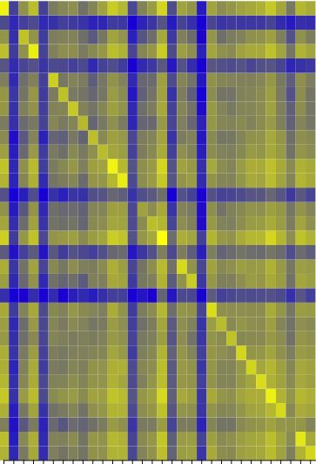
How Benefit-Aware Clustering works
D
P
T
Chunking
Sample
Wavelet
double T[3000];
double V[10];
double P[5000];
double D[4000];
double R[100];
double D[4000];
double P[5000];
double T[3000];
double T[3000];
double P[5000];
double D[4000];
P₁
P₂
P₃
P₄
P₅
D
P
T
Cluster 1
P₁
Cluster 2
P₃
P₄
P₂
P₅
β(14
)
Filter
Order
Similarity
Cluster
Notes:
Enzo: 79% single precision
Cactus: 88% double precision
Second filtering criterion is by data type.

Slide 35
Structure of mcrCluster
P₅
F
O
S
C
P₄
Aggregator
F
O
S
C
A₂
PFS
P₃
Aggregator
F
O
S
C
A₁
P₂
F
O
S
C
P₁
F
O
S
C
Compute Node

Slide 36
Evaluation
Application
  IOR (synthetic checkpoints)
  Cactus
Experimental test-bed
  LLNL’s Sierra: 261.3 TFLOP/s, Linux cluster
  23,328 cores, 1.3 Petabyte Lustre file system
Evaluation metric:
  Macro benchmark: Effectiveness of clustering
  Micro benchmark: Effectiveness of sampling

Slide 37
Effectiveness of mcrCluster
IOR: 32 checkpoints
  Odd processes write 0
  Even processes write: <rank> | 1234567
  29% more compression compared to rank-wise, 22% more compared to random grouping

Slide 38
Effectiveness of Sampling
X axis: Each variable
Y axis: Range of benefit values
Take away:
  Chunking method preserves benefit relationships the closest
Chunking
Wavelet Transform
Notes:
Use 3 representative variables for w/o sampling, w/ chunking, and w/ wavelet transform.

Slide 39
Contributions of mcrCluster
Design similarity and distance metric
Demonstrate significant result on synthetic data
  22% and 29% improvement compared to random and rank-wise clustering, respectively
Future directions for a first year Ph.D. student
  Study impact on real applications
  Design scalable clustering technique

Slide 40
Applicability of My Research
Condor systems
Compression for scientific data
Notes:
Put technical details as second level bullets.

Slide 41
Conclusions
This thesis addresses:
  Reliability of checkpointing-based recovery in large-scale computing
Proposed three novel systems:
  Falcon: Distributed checkpointing system for Grids
  mcrEngine: “Data-Aware Compression” and scalable checkpointing system for HPC
  mcrCluster: “Benefit-Aware Clustering”
Provides a good foundation for further research in this field

Slide 42
Questions?

Slide 43
Future Directions: Reliability
Reliability: Similarity-based process grouping for better compression
  Group processes based on similarity instead of rank [On going]
  Analytical solution to group size selection
  Variable streaming
Integrating mcrEngine with SCR

Slide 44
Future Directions: Performance
Cache usage analysis and optimization
  Developed user-level tool for analyzing cache utilization [Summer’12]
  Short term goals:
    Apply to real-applications
    Automate analysis
  Long-term goals:
    Suggest potential code optimizations
    Automate application tuning

Slide 45
Contact Information
Tanzima Islam (tislam@purdue.edu)
Website: web.ics.purdue.edu/~tislam
Notes:
(1) With this I finish my presentation and will gladly answer any question.

Slide 46
Effectiveness of mcrCluster

Slide 47
Backup Slides

Slide 48
[Backup Slide] Failures in HPC
“A Large-scale Study of Failures in High-performance Computing Systems”, by Bianca Schroeder, Garth Gibson
Breakdown of root causes of failures
Breakdown of downtime into root causes

Slide 49
[Backup Slide] Failures in HPC
“Hiding Checkpoint Overhead in HPC Applications with a Semi-Blocking Algorithm”, by Laxmikant Kalé et. al.
Disparity between network bandwidth and memory size

Slide 50
[Backup Slides] Falcon

Slide 51
[Backup Slide] Breakdown of Overheads
Performance scales with checkpoint sizes
Lower network transfer overhead

Slide 52
[Backup Slide] Parallel Falcon
67% improvement in CPU time

Slide 53
[Backup Slides] mcrEngine

Slide 54
[Backup Slide] How to Find Similarity
Var: “ToyGrp/Temperature”
Type: F32LE, Array1[1024]
ToyGrp/Temperature_F32LE_Array1D
P₀
Var: “ToyGrp/Pressure”
Type: S8LE, Array2D [20][30]
ToyGrp/Pressure_S8LE_Array2D
Group ToyGrp{
float Temperature[1024];
short Pressure[20][30];
int Humidity;
};
Var: “ToyGrp/Humidity”
Type: I32LE, Atomic
ToyGrp/Humidity_I32LE_Atomic
Var: “ToyGrp/Temperature”
Type: F32LE, Array1D [50]
ToyGrp/Temperature_F32LE_Array1D
P₁
Group ToyGrp{
float Temperature[50];
short Pressure[2][6];
double Unit;
int Humidity;
};
Var: “ToyGrp/Pressure”
Type: S8LE, Array2D [2][6]
ToyGrp/Pressure_S8LE_Array2D
Var: “ToyGrp/Unit”
Type: F64LE, Atomic
ToyGrp/Unit_F64LE_Atomic
No match
Inside source code: Variables represented as members of a group in actual source code. A group can be thought of the construct “Struct” in C
Var: “ToyGrp/Humidity”
Type I32LE, Atomic
ToyGrp/Humidity_I32LE_Atomic
Inside a checkpoint: Variables annotated with metadata
Generated hash key for matching

Slide 55
[Backup Slide] Compression Ratio Follows Course of Simulation
Data-aware technique always yields better compression
Cactus
Aware-Block
Aware
Agnostic-Block
Compression Ratio
Agnostic
Cosmology
Implosion
Simulation Time-steps
Notes:
1) Then, we studied how compression ratio changes as simulation progresses.
(2) For thee 3 applications, X axis shows checkpoints taken at different time steps, and Y axis shows compression ratio
(3) For Cosmolgoy and Implosion, we see high compression ratio at the beginning of a simulation because these were the checkpoints with
Variables initialized to default initialized. Cactus however, did not have any default initialization values.
(4) We can see two trends here. For some applications, checkpoints are very compressionble at the beginning, and the end -- like implosion. As opposed to cactus, where compression ratio stays almost flat through out the simulation. Our intuition tells us that data computed by cactus may have the same amount of variability throuhout the run.

Slide 56
[Backup Slide] Relative Improvement in Compression Ratio Compared to Data-Agnostic Scheme
Application | Total Size (GB) | Data Types(%) D F S F Int |  |  | Aware-Block (%) | Aware (%)
ALE3D | 4.8 | 88.8 | ~0 | 11.2 | 6.6 - 27.7 | 6.6 - 12.7
Cactus | 2.41 | 33.94 | 0 | 66.06 | 10.7 – 11.9 | 98 - 115
Cosmology | 1.1 | 24.3 | 67.2 | 8.5 | 20.1 – 25.6 | 20.6 – 21.1
Implosion | 0.013 | 0 | 74.1 | 25.9 | 36.3 – 38.4 | 36.3 – 38.8
Notes:
This table summarizes relative improvement in compression ratio for data-aware schemes compared to data-agnostic ones. The reduction in size is in giga bytes.

Slide 57
References
M. Burtscher and P. Ratanaworabhan, “FPC: A High-speed Compressor for Double-Precision Floating-Point Data”.
P. Lindstrom and M. Isenburg, “Fast and Efficient Compression of Floating-Point Data”.
L. Reinhold, “QuickLZ”.

Slide 58
Reliable and Efficient System for Storing Checkpoints in Grid
Execution Environment: Grid

Slide 59

State-of-the-Art:
Checkpointing in Grid with Dedicated Storage
@Notre Dame
@Purdue
@Indiana U.
Internet
Dedicated
Storage Server
Problems:
(−) High transfer latency
(−) Contention on servers
(−) Stress on shared network resources
Submitter
Notes:
1. Introduce DiaGrid – 30K cores, 9 universitiies

Slide 60
Research Question
Can we improve the performance of applications by storing checkpoints on the grid resources?

Slide 61
Overview of Our Solution:
Checkpointing in Grid with Distributed Storage
@Notre Dame
@Purdue
@Indiana U.
Internet
Q1. Which storage nodes?
Q2. How to balance load?
Q3. How to efficiently storage & retrieve?
Constraint:
-- All components must be user-level
Submitter

Slide 62
Answer to Q1: Storage Host Selection
Build failure model for storage resources
Compute correlated temporal reliability
  Based on historical data
Rank machines
  Based on: reliability, load, and network overhead
Output:
  (m+k) storage hosts
Addresses Q2
Compute Host
down
Objective function:
checkpoint storing overhead – benefit from restart
down
Storage Host 1
down
down
Storage Host 2

Slide 63
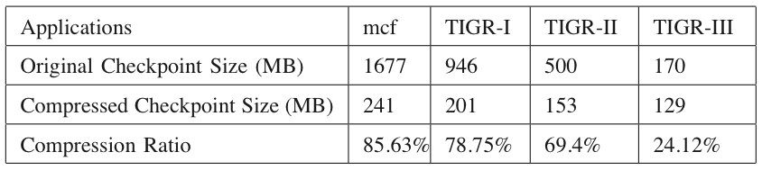
Checkpoint-Recovery Scheme
Disk
Disk
Original Checkpoint
Original Checkpoint
Compression
Decompression
Compressed
Compressed
Erasure Encoding
(m+k)
Erasure Decoding
(m)
Fragments
Fragments
Storage Host
Storage Host
1
2
m+k
1
2
m+k
Checkpoint Storing Phase
Recovery Phase
Notes:
Now that we have a list of reliable storage hosts, let’s see how our checkpoint recovery scheme works.
During a ckpt storing phase, an app generates a ckpt on the disk
our scheme compresses these checkpoints. Say, system level ckpts are compressible and why.
then encodes into m+k fragments
sends in parallel to m+k storage hosts.
During a recovery phase, reads, decodes, decompresses and regenerates for apps to use.

Slide 64
Evaluation Setup
2 different applications with 4 input sets
  MCF (SPEC CPU 2006)
  TIGR (BioBench)
System-level checkpoints
Macro benchmark experiment
  Average job makespan
Micro benchmark experiments
  Efficiency of checkpoint and restart
  Efficiency in handling simultaneous clients
  Efficiency in handling multiple failures

Slide 65
Checkpoint Storing & Recovery Overhead
Performance scales with checkpoint sizes
Lower network transfer overhead
Transfer Overhead
CPU Overhead
Notes:
-- Cpu time includes compression and encoding times. Compression time being the dominant factor.
-- Mention: We parallelized these two phases and found 67% of improvement in cpu overhead

Slide 66
Overall Performance Comparison
Performance improvement between 11% and 44%
Remote Dedicated Server
Local Dedicated Server
Falcon with Distributed Server

Slide 67
Summary of Reliable Checkpointing System
Developed a reliable checkpoint-recovery system falcon
  Select reliable storage hosts
  Prefer lightly loaded ones
  Compress and encode
  Store and retrieve efficiently
Ran experiments with falcon in DiaGrid
  Performance improvement between 11% and 44%
Notes:
Erasure coding → Explain m+k and how it improved fault tolerance.

Slide 68
Checkpointing in HPC
Compute Nodes
Network Contention
Gateway Nodes
Contention for Shared File System Resources
Atlas
Contention for Other Clusters for File System
Hera
Hera
Parallel File System

Slide 69
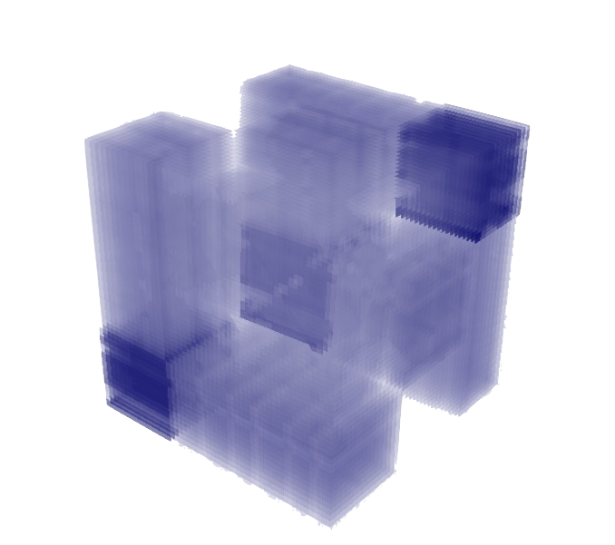
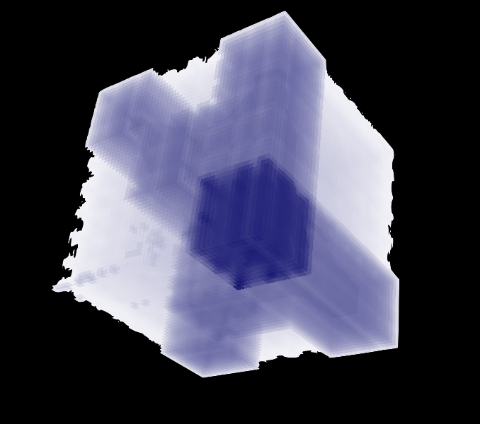
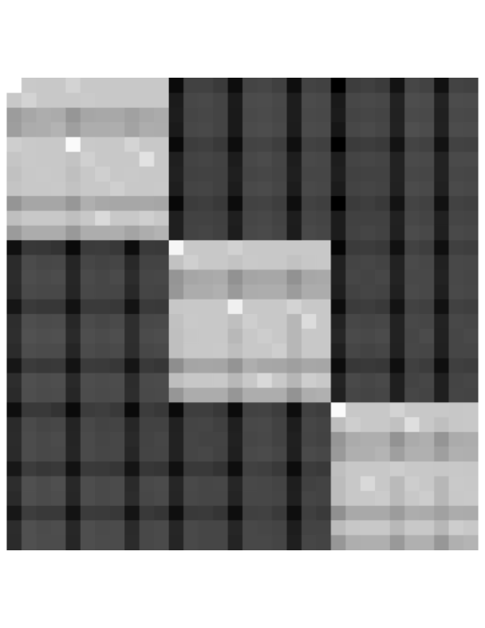
2-D vs N-D Compression
Notes:
Cactus

Slide 71
Challenge in Extreme-Scale: Increase in Failure-Rate
100 Pflop/s
10 Pflop/s
1 Pflop/s
100 Tflop/s
N=1
10 Tflop/s
1 Tflop/s
N=500
100 Gflop/s
10 Gflop/s
1 Gflop/s
Notes:
Performance Development in Top500
Sequoia uses 1572864 cores.

Slide 72
Towards Online Clustering
Reduce dimension of β
Reduce the number of variables
  Representative data-type
  Number of elements greater than a threshold [Example: 100 variables double-type covers 80% of data]
Reduce the amount of data
  Sampling: Random, chunking and wavelet

