Slide 1
Techniques for Finding Scalability Bugs
Bowen Zhou

Slide 2
Overview
Find scaling bugs using WuKong
Generate scaling test inputs using Lancet

Slide 3
Overview
Find scaling bugs using WuKong
Generate scaling test inputs using Lancet

Slide 4
A Real Bug in MPI
A bug in MPI_Allgather in MPICH2-1.1
Allgather is a collective communication procedure which allows every process gathers data from all processes
P1
P1
Allgather
P2
P2
P3
P3

Slide 5
A Real Bug in MPI
MPICH2 uses distinct algorithms to do Allgather in different situations
Optimal algorithm is selected based on the total amount of data received by each process
Notes:
Latency and transmission. Small data, latency dominant, so we go for recdbl where you have less number of iterations; large data, transmission dominant, we go for ring where you only communicate with nearest neighbors

Slide 6
A Real Bug in MPI
int MPIR_Allgather (
……
int recvcount,
MPI_Datatype recvtype,
MPID_Comm *comm_ptr )
{
int comm_size, rank;
int curr_cnt, dst, type_size, left, right, jnext, comm_size_is_pof2;
……
if ((recvcount*comm_size*type_size < MPIR_ALLGATHER_LONG_MSG) &&
(comm_size_is_pof2 == 1)) {
/* Short or medium size message and power-of-two no. of processes.
* Use recursive doubling algorithm */
……
else if (recvcount*comm_size*type_size < MPIR_ALLGATHER_SHORT_MSG) {
/* Short message and non-power-of-two no. of processes. Use
* Bruck algorithm (see description above). */
……
else { /* long message or medium-size message and non-power-of-two
* no. of processes. use ring algorithm. */
……
recvcount*comm_size*type_size can easily overflow a 32-bit integer on large systems and fail the if statement
Notes:
Emphasize it is a noncrashing bug
1.Due to an integer overflow in the computation of total amount of data, it may choose a suboptimal algorithm for large-scale runs
2.As a result, the bug may cause a substantial slowdown in the Allgather operation if the total amount of data exceeds MAX_INT
3.comm_size

Slide 7
Scale-dependent Bugs
Behavioral Characteristics
Remain unnoticed at small scales
Manifest at large scale runs
Examples
The integer overflow in MPI_Allgather
An infinite loop triggered by receiving a large DHT message in Transmission
A LRU cache implemented as a linked list in MySQL
Notes:
Small scale: e.g. running tests on development machines
Large scale: e.g. when the application is running on a large-scale system, handling a large amount of data, processing requests from a high number of concurrent clients, etc.

Slide 8
Statistical Debugging
Previous Works [Bronevetsky DSN ‘10] [Mirgorodskiy SC ’06] [Chilimbi ICSE ‘09] [Liblit PLDI ‘03]
Represent program behaviors as a set of features
Build models of these features based on training runs
Apply the models to production runs
detect anomalous features
identify the features strongly correlated with failures
Notes:
Features: such as function frequency, path profile, and predicate

Slide 9
Modeling Scale-dependent Behavior
Training runs
Production runs
# OF TIMES LOOP EXECUTES
Is there a bug in one of the production runs?
RUN #
Notes:
# of times a loop executes and the id of each run.
Not accounting for scaling behavior, we got a model that cover the full range of behaviors. You would consider all the production runs have not bug. In fact, all of them look fine.
However, if we consider scale, you can find a clear trend between scale and the number of time the loop executes. And only one of the production run is correct, while the other two execute the loop for less iterations than they should have.

Slide 10
Modeling Scale-dependent Behavior
Training runs
Production runs
# OF TIMES LOOP EXECUTES
Is there a bug in one of the production runs?
Previous Models
RUN #
Notes:
# of times a loop executes and the id of each run.
Not accounting for scaling behavior, we got a model that cover the full range of behaviors. You would consider all the production runs have not bug. In fact, all of them look fine.
However, if we consider scale, you can find a clear trend between scale and the number of time the loop executes. And only one of the production run is correct, while the other two execute the loop for less iterations than they should have.

Slide 11
Modeling Scale-dependent Behavior
Training runs
Production runs
# OF TIMES LOOP EXECUTES
Is there a bug in one of the production runs?
Previous Models
RUN #
Notes:
# of times a loop executes and the id of each run.
Not accounting for scaling behavior, we got a model that cover the full range of behaviors. You would consider all the production runs have not bug. In fact, all of them look fine.
However, if we consider scale, you can find a clear trend between scale and the number of time the loop executes. And only one of the production run is correct, while the other two execute the loop for less iterations than they should have.

Slide 12
Modeling Scale-dependent Behavior
Training runs
Production runs
# OF TIMES LOOP EXECUTES
Accounting for scale makes trends clear, errors at large scales obvious
INPUT SIZE

Slide 13
Previous Research
Vrisha [HPDC '11]
A single aggregate model for all features
Detect bugs caused by any feature
Difficult to pinpoint individual features correlated with a failure

Slide 14
Vrisha
Kernel Canonical Correlation Analysis takes observational feature X and control feature Y to find f and g such that f(X) and g(Y) is highly correlated
y
Behavioral Feature
corr(f( ), g( )) < 0
BUG!
x
Scale of Execution

Slide 15
Previous Research
Abhranta [HotDep '12]
A augmented model that allows per-feature reconstruction

Slide 16
Abhranta
ABHRANTA replaced non-linear transform used by Vrisha with an invertible linear transform g(*) for observational features
The new model provides an automatic way to reconstruct “bug-free” behavior at large scales
g⁻¹(f (x))
g⁻¹(*)
f(x)
x
Notes:
Describe in operational way

Slide 17
Limitations of Previous Research
Big gap between the scales of training and production runs
E.g. training runs on 128 nodes, production runs on 1024 nodes
Noisy feature
No feature selection in model building
Too many false positives

Slide 18
WuKong [HPDC ‘13]
Predicts the expected value in a large-scale run for each feature separately
Prunes unpredictable features to improve localization quality
Provides a shortlist of suspicious features in its localization roadmap

Slide 19
The Workflow
APP
SCALE
SCALE
SCALE
PIN
FEATURE
FEATURE
RUN 1
RUN 1
APP
SCALE
PIN
FEATURE
MODEL
RUN 2
RUN 2
APP
SCALE
PIN
FEATURE
RUN 3
RUN 3
APP
SCALE
FEATURE
...
...
PIN
FEATURE
RUN 4
RUN 4
=
?
APP
SCALE
PIN
FEATURE
RUN N
RUN N
Training
Production

Slide 20
Feature
void foo(int a) {
1:if (a > 0) {
} else {
}
2:if (a > 100) {
int i = 0;
3:while (i < a) {
4:if (i % 2 == 0) {
}
++i;
}
}
}
1
2
3
4

Slide 21
Model
X ~ vector of scale parameters X1...XN
Y ~ number of occurrences of a feature
The model to predict Y from X:
Compute the relative prediction error:

Slide 22
Inference: Bug Localization
First, we need to determine if the production run is buggy:
If there is a bug in this run, we rank all the features by their prediction errors
Output the top N features as a roadmap for locating the bug
Error of feature i
in the production run
Constant parameter
Max error of feature i
in all training runs

Slide 23
Optimization: Feature Pruning
Some noisy features cannot be effectively predicted by the above model
Not correlated with scale, e.g. random
Discontinuous
Notes:
Effects of feature pruning:
Prevent noisy features with high prediction error from polluting the diagnosis result
Miss some bugs if they happens to be located in these noisy features

Slide 24
Optimization: Feature Pruning
How to remove noisy features?
If we cannot predict them well for the training runs, we cannot predict them for the large scale runs
Algorithm
For each feature:
Do a cross validation with training runs
Remove the feature if it triggers a high prediction error in a large fraction of training runs
E.g. 115% prediction error in 90% training runs
A tuning knob is provided to control the feature selection to tolerate outliers

Slide 25
Evaluation
Large-scale study of LLNL Sequoia AMG2006
Up to 1024 processes
Two case studies of real bugs
Integer overflow in MPI_Allgather
Infinite loop in Transmission, a popular P2P file sharing application

Slide 26
AMG2006: Modeling Accuracy
Trained on 8-128 processes
Compared predicted behavior at 256, 512 and 1024 processes with actual (non-buggy) behavior
Scale of Run | Mean Prediction Error
256 | 6.55%
512 | 8.33%
1024 | 7.77%

Slide 27
AMG2006: Fault Injection
Fault
Injected at rank 0
Randomly pick a branch to flip
Data
Training: No fault 110 runs @ 8-128 processes
Testing: With fault 100 runs @ 1024 processes
Result
Total | 100
Non-Crashing | 57
Detected | 53
Localized | 49
Localization Ratio | 49/53 = 92.5%

Slide 28
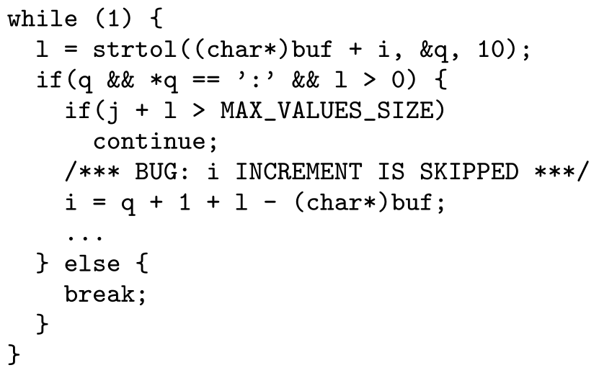
Case Study: An Infinite Loop in Transmission

Slide 29
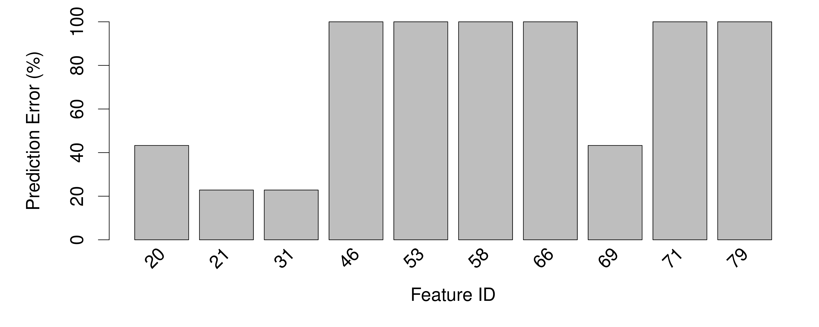
Case Study: An Infinite Loop in Transmission
Notes:
Why choose 53 and 66? What about 46, 58, 71, 79?

Slide 30
Case Study: An Infinite Loop in Transmission
Feature 53, 66

Slide 31
Summary of WuKong
Debugging scale-dependent program behavior is a difficult and important problem
WuKong incorporates scale of run into a predictive model for each individual program feature for accurate bug diagnosis
We demonstrated the effectiveness of WuKong through a large-scale fault injection study and two case studies of real bugs

Slide 32
Overview
Find scaling bugs using WuKong
Generate scaling test inputs using Lancet

Slide 33
Motivation
A series of increasingly scaled inputs are necessary for modeling the scaling behaviors of an application
Provide a systematic and automatic way to performance testing
Notes:
Specifically, we want to observe the correlation between the input and each individual feature, e.g. the trip count of a loop, the number of times a true branch is taken, etc.

Slide 34
Common Practice for Performance Testing
Rely on human expertise of the program to craft “large” tests
E.g. a longer input leads to longer execution time, a larger number of clients causes higher response time
Stress the program as a whole instead of individual components of the program
Not every part of the program scales equally
Less-visited code paths are more vulnerable to a heavy workload

Slide 35
Symbolic Execution
The goal is to generate inputs that follow specific execution paths
Basic algorithm [Cadar CCS’06]:
Run code on symbolic input, initial value = “anything”
As code observes input, it tells us values input can be.
At conditionals that use symbolic input, fork
on true branch, add constraint that input satisfies check
on false that it does not.
Exit() or error: solve constraints for input.

Slide 36
Symbolic Execution
tokenize_command(char *cmd,…) {
char *s, *e;
size_t len = strlen(cmd);
unsigned int i = 0;
s = e = cmd;
for (i = 0; i < len; i++, e++) {
if (*e == ’ ’) {
if (s != e) { /* add a new token */ }
s = e + 1;
}
}
Variable | Value
cmd | symbolic
s
*s
e
*e
len
i
type: string
addr: 0x1000
size: 8
Path Condition
NULL

Slide 37
Symbolic Execution
tokenize_command(char *cmd,…) {
char *s, *e;
size_t len = strlen(cmd);
unsigned int i = 0;
s = e = cmd;
for (i = 0; i < len; i++, e++) {
if (*e == ’ ’) {
if (s != e) { /* add a new token */ }
s = e + 1;
}
}
Variable | Value
cmd | symbolic
s | 0x1000
*s | cmd[0]
e | 0x1000
*e | cmd[0]
len | 8
i | 0
Path Condition
NULL

Slide 38
Symbolic Execution
tokenize_command(char *cmd,…) {
char *s, *e;
size_t len = strlen(cmd);
unsigned int i = 0;
s = e = cmd;
for (i = 0; i < len; i++, e++) {
if (*e == ’ ’) {
if (s != e) { /* add a new token */ }
s = e + 1;
}
}
Variable | Value
cmd | symbolic
s | 0x1000
*s | cmd[0]
e | 0x1000
*e | cmd[0]
len | 8
i | 0
fork!
Path Condition
NULL

Slide 39
Symbolic Execution
tokenize_command(char *cmd,…) {
char *s, *e;
size_t len = strlen(cmd);
unsigned int i = 0;
s = e = cmd;
for (i = 0; i < len; i++, e++) {
if (*e == ’ ’) {
if (s != e) { /* add a new token */ }
s = e + 1;
}
}
Variable | Value
cmd | symbolic
s | 0x1000
*s | cmd[0]
e | 0x1001
*e | cmd[1]
len | 8
i | 1
Path Condition
cmd[0] ≠ ‘ ‘

Slide 40
Symbolic Execution
tokenize_command(char *cmd,…) {
char *s, *e;
size_t len = strlen(cmd);
unsigned int i = 0;
s = e = cmd;
for (i = 0; i < len; i++, e++) {
if (*e == ’ ’) {
if (s != e) { /* add a new token */ }
s = e + 1;
}
}
Variable | Value
cmd | symbolic
s | 0x1000
*s | cmd[0]
e | 0x1001
*e | cmd[1]
len | 8
i | 1
fork!
Path Condition
cmd[0] ≠ ‘ ‘

Slide 41
Symbolic Execution
tokenize_command(char *cmd,…) {
char *s, *e;
size_t len = strlen(cmd);
unsigned int i = 0;
s = e = cmd;
for (i = 0; i < len; i++, e++) {
if (*e == ’ ’) {
if (s != e) { /* add a new token */ }
s = e + 1;
}
}
Variable | Value
cmd | symbolic
s | 0x1000
*s | cmd[0]
e | 0x1002
*e | cmd[2]
len | 8
i | 2
Path Condition
cmd[0] ≠ ‘ ‘ ˄ cmd[1] ≠ ‘ ‘

Slide 42
Symbolic Execution
tokenize_command(char *cmd,…) {
char *s, *e;
size_t len = strlen(cmd);
unsigned int i = 0;
s = e = cmd;
for (i = 0; i < len; i++, e++) {
if (*e == ’ ’) {
if (s != e) { /* add a new token */ }
s = e + 1;
}
}
Variable | Value
cmd | symbolic
s | 0x1000
*s | cmd[0]
e | 0x1002
*e | cmd[2]
len | 8
i | 2
fork!
Path Condition
cmd[0] ≠ ‘ ‘ ˄ cmd[1] ≠ ‘ ‘

Slide 43
Symbolic Execution
tokenize_command(char *cmd,…) {
char *s, *e;
size_t len = strlen(cmd);
unsigned int i = 0;
s = e = cmd;
for (i = 0; i < len; i++, e++) {
if (*e == ’ ’) {
if (s != e) { /* add a new token */ }
s = e + 1;
}
}
Variable | Value
cmd | symbolic
s | 0x1000
*s | cmd[0]
e | 0x1003
*e | cmd[3]
len | 8
i | 3
Path Condition
cmd[0] ≠ ‘ ‘ ˄ cmd[1] ≠ ‘ ‘ ˄ cmd[2] ≠ ‘ ‘

Slide 44
Symbolic Execution
tokenize_command(char *cmd,…) {
char *s, *e;
size_t len = strlen(cmd);
unsigned int i = 0;
s = e = cmd;
for (i = 0; i < len; i++, e++) {
if (*e == ’ ’) {
if (s != e) { /* add a new token */ }
s = e + 1;
}
}
Variable | Value
cmd | symbolic
s | 0x1000
*s | cmd[0]
e | 0x1003
*e | cmd[3]
len | 8
i | 3
fork!
Path Condition
cmd[0] ≠ ‘ ‘ ˄ cmd[1] ≠ ‘ ‘ ˄ cmd[2] ≠ ‘ ‘

Slide 45
Symbolic Execution
tokenize_command(char *cmd,…) {
char *s, *e;
size_t len = strlen(cmd);
unsigned int i = 0;
s = e = cmd;
for (i = 0; i < len; i++, e++) {
if (*e == ’ ’) {
if (s != e) { /* add a new token */ }
s = e + 1;
}
}
Variable | Value
cmd | symbolic
s | 0x1000
*s | cmd[0]
e | 0x1003
*e | cmd[3]
len | 8
i | 3
not fork!
Path Condition
cmd[0] ≠ ‘ ‘ ˄ cmd[1] ≠ ‘ ‘ ˄ cmd[2] ≠ ‘ ‘ ˄ cmd[3] = ‘ ‘

Slide 46
Symbolic Execution
tokenize_command(char *cmd,…) {
char *s, *e;
size_t len = strlen(cmd);
unsigned int i = 0;
s = e = cmd;
for (i = 0; i < len; i++, e++) {
if (*e == ’ ’) {
if (s != e) { /* add a new token */ }
s = e + 1;
}
}
Variable | Value
cmd | symbolic
s | 0x1004
*s | cmd[0]
e | 0x1003
*e | cmd[3]
len | 8
i | 3
Path Condition
cmd[0] ≠ ‘ ‘ ˄ cmd[1] ≠ ‘ ‘ ˄ cmd[2] ≠ ‘ ‘ ˄ cmd[3] = ‘ ‘

Slide 47
Symbolic Execution
tokenize_command(char *cmd,…) {
char *s, *e;
size_t len = strlen(cmd);
unsigned int i = 0;
s = e = cmd;
for (i = 0; i < len; i++, e++) {
if (*e == ’ ’) {
if (s != e) { /* add a new token */ }
s = e + 1;
}
}
Variable | Value
cmd | symbolic
s | 0x1004
*s | cmd[0]
e | 0x1004
*e | cmd[4]
len | 8
i | 4
Path Condition
cmd[0] ≠ ‘ ‘ ˄ cmd[1] ≠ ‘ ‘ ˄ cmd[2] ≠ ‘ ‘ ˄ cmd[3] = ‘ ‘

Slide 48
Symbolic Execution versus Loop
Plain symbolic execution handles loops poorly
path explosion
consult the SMT solver at each symbolic branch
WISE [Burnim ICSE’09] is a symbolic execution tool for generating worst-case inputs
Small scale: apply exhaustive search to find all paths and remember which branches lead to longer paths
Large scale: follow the same branches that lead to longer paths at small scales
Notes:
WISE controls path explosion but still queries the SMT solver at each symbolic branch.

Slide 49
Key Idea
The constraints generated by the same conditional are highly predictable
E.g. cmd[0] ≠ ‘ ‘ ˄ cmd[1] ≠ ‘ ‘ ˄ cmd[2] ≠ ‘ ‘ ˄ cmd[3] = ‘ ‘
Infer the path condition of N iterations from the path conditions of up to M iterations (M<<N)
Notes:
For every iteration between M and N:
Skip path exploration
Avoid solving the path conditions

Slide 50
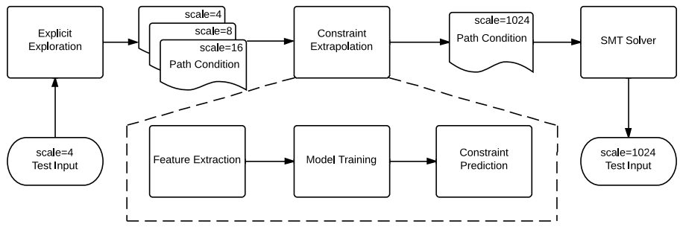
Lancet
Performance test generation for loops
Explicit mode to generate small-scale path conditions using symbolic execution
Inference mode to derive large-scale path conditions from the data generated in the explicit mode

Slide 51
Explicit Mode
Find the path conditions for up to M iterations
Exhaustive search to reach the target loop from entry point
Then prioritize paths that stay in the loop to reach different numbers of iterations quickly
Find as many distinct paths that reach the target range of trip count as possible within the given time

Slide 52
Inference Mode
Infer the N-iteration path condition from the training data generated by the explicit mode
Query the SMT solver to generate a test input from the N-iteration path condition
Verify the generated input in concrete execution

Slide 53
Inference of Path Condition
Compare the path conditions of M iterations and M+1 iterations: P_{M} and P_{M+1} to find the differential set of constraints D_{M+1}
Predict the N-iteration path condition P_{N} by appending N-M copies of D_{M+1} to the M-iteration path condition P_{M}
D_{M+1} = P_{M+1} – P_{M}
P_{N} = P_{M} + (N – M) × D_{M+1}

Slide 54
Compute Differential Set
Group constraints by the instruction that introduces them
Sort every constraint group by the lowest address of symbolic variable accessed by each constraint
Each ordered group of constraints form a feature
For path conditions P_{i} and P_{i+1} of i and i+1 iterations, the differential set for the jth feature is the residual part of after removing the longest common prefix between and

Slide 55
An Example Loop
A loop to fetch keys for a get command from an array of tokens extracted from a string by tokenize_command
The number of iterations is determined by the number of keys in the command
void process_get_command(token_t *tokens,…) {
token_t *key_token = &tokens[KEY_TOKEN];
while (key_token->length != 0) {
/* retrieve the key from cache */
key_token++;
}
}
Iterations | Path Condition
1 | cmd[0] = ‘g‘ ˄ cmd[1] = ‘e‘ ˄ cmd[2] = ‘t‘ ˄ cmd[3] = ‘ ‘ ˄ cmd[4] ≠ ‘ ‘ ˄ cmd[5] ≠ ‘ ‘ ˄ cmd[6] ≠ ‘ ‘ ˄ cmd[7] ≠ ‘ ‘
2 | cmd[0] = ‘g‘ ˄ cmd[1] = ‘e‘ ˄ cmd[2] = ‘t‘ ˄ cmd[3] = ‘ ‘ ˄ cmd[4] ≠ ‘ ‘ ˄ cmd[5] = ‘ ‘ ˄ cmd[6] ≠ ‘ ‘ ˄ cmd[7] ≠ ‘ ‘

Slide 56
An Example Loop
A loop to fetch keys for a get command from an array of tokens extracted from a string by tokenize_command
The number of iterations is determined by the number of keys in the command
void process_get_command(token_t *tokens,…) {
token_t *key_token = &tokens[KEY_TOKEN];
while (key_token->length != 0) {
/* retrieve the key from cache */
key_token++;
}
}
Iterations | Path Condition
1 | cmd[0] = ‘g‘ ˄ cmd[1] = ‘e‘ ˄ cmd[2] = ‘t‘ ˄ cmd[3] = ‘ ‘ ˄ cmd[4] ≠ ‘ ‘ ˄ cmd[5] ≠ ‘ ‘ ˄ cmd[6] ≠ ‘ ‘ ˄ cmd[7] ≠ ‘ ‘
2 | cmd[0] = ‘g‘ ˄ cmd[1] = ‘e‘ ˄ cmd[2] = ‘t‘ ˄ cmd[3] = ‘ ‘ ˄ cmd[4] ≠ ‘ ‘ ˄ cmd[5] = ‘ ‘ ˄ cmd[6] ≠ ‘ ‘ ˄ cmd[7] ≠ ‘ ‘

Slide 57
An Example Loop
A loop to fetch keys for a get command from an array of tokens extracted from a string by tokenize_command
The number of iterations is determined by the number of keys in the command
void process_get_command(token_t *tokens,…) {
token_t *key_token = &tokens[KEY_TOKEN];
while (key_token->length != 0) {
/* retrieve the key from cache */
key_token++;
}
}
Iterations | Differential Set
2 | cmd[5] = ‘ ‘ ˄ cmd[6] ≠ ‘ ‘ ˄ cmd[7] ≠ ‘ ‘

Slide 58
Extrapolate Differential Set
Get constraint templates from differential set
Replace symbolic variables and concrete numbers in each constraint with abstract terms numbered by their appearances
Infer the values for abstract terms based on the trends observed in the series of differential sets of small numbers of iterations

Slide 59
An Example Loop
A loop to fetch keys for a get command from an array of tokens extracted from a string by tokenize_command
The number of iterations is determined by the number of keys in the command
void process_get_command(token_t *tokens,…) {
token_t *key_token = &tokens[KEY_TOKEN];
while (key_token->length != 0) {
/* retrieve the key from cache */
key_token++;
}
}
Iterations | Constraint Templates
2 | cmd[x₁] = x₂ ˄ cmd[x₃] ≠ x₄ ˄ cmd[x₅] ≠ x₆

Slide 60
An Example Loop
A loop to fetch keys for a get command from an array of tokens extracted from a string by tokenize_command
The number of iterations is determined by the number of keys in the command
void process_get_command(token_t *tokens,…) {
token_t *key_token = &tokens[KEY_TOKEN];
while (key_token->length != 0) {
/* retrieve the key from cache */
key_token++;
}
}
Iterations | Differential Set
3 | cmd[8] = ‘ ‘ ˄ cmd[9] ≠ ‘ ‘ ˄ cmd[10] ≠ ‘ ‘
4 | cmd[11] = ‘ ‘ ˄ cmd[12] ≠ ‘ ‘ ˄ cmd[13] ≠ ‘ ‘
5 | cmd[14] = ‘ ‘ ˄ cmd[15] ≠ ‘ ‘ ˄ cmd[16] ≠ ‘ ‘

Slide 61
Assembly Path Condition
Concatenate the base path condition and all differential sets to form the N-iteration path condition
If there are contradictive constraints in two consecutive differential sets, keep the latest constraints
D1
D2
+
D3
D1
D2
D3

Slide 62
An Example Loop
A loop to fetch keys for a get command from an array of tokens extracted from a string by tokenize_command
The number of iterations is determined by the number of keys in the command
void process_get_command(token_t *tokens,…) {
token_t *key_token = &tokens[KEY_TOKEN];
while (key_token->length != 0) {
/* retrieve the key from cache */
key_token++;
}
}
Iterations | Path Condition
5 | cmd[0] = ‘g‘ ˄ cmd[1] = ‘e‘ ˄ cmd[2] = ‘t‘ ˄ cmd[3] = ‘ ‘ ˄ cmd[4] ≠ ‘ ‘ ˄ cmd[5] = ‘ ‘ ˄ cmd[6] ≠ ‘ ‘ ˄ cmd[7] ≠ ‘ ‘ ˄ cmd[8] = ‘ ‘ ˄ cmd[9] ≠ ‘ ‘ ˄ cmd[10] ≠ ‘ ‘ ˄ cmd[11] = ‘ ‘ ˄ cmd[12] ≠ ‘ ‘ ˄ cmd[13] ≠ ‘ ‘ ˄ cmd[14] = ‘ ‘ ˄ cmd[15] ≠ ‘ ‘ ˄ cmd[16] ≠ ‘ ‘

Slide 63
Evaluation
Explicit Mode versus KLEE
Case Study: Memcached

Slide 64
Case Study: Memcached
Changes to the symbolic execution engine
Support pthread
Treat network I/O as symbolic file read/write
Handle event callbacks for symbolic files
Changes to memcached
Simplify a hash function used for key mapping
Create an incoming connection via symbolic socket to accept a single symbolic packet
Removed unused key expiration events

Slide 65
Case Study: Memcached
Target: the while loop in the previous example
Generated 20 tests in 5 minutes
Iter # | Path Condition
1 | get *
2 | get * *
3 | get ** * ****
4 | get ** * * *
The symbol ‘*’ means any non-space character, e.g. the path condition ‘get *’ means:
cmd[0] = ‘g‘ ˄ cmd[1] = ‘e‘ ˄ cmd[2] = ‘t‘ ˄ cmd[3] = ‘ ‘ ˄ cmd[4] ≠ ‘ ‘

Slide 66
Case Study: Memcached
Target: the while loop in the previous example
Generated 20 tests in 5 minutes
Iter # | Path Condition
1 | get *
2 | get * *
3 | get ** * ****
4 | get ** * * *
Minimal differential set between iteration 1 and 2 is:
cmd[5] = ‘ ‘ ˄ cmd[6] = ‘ ‘ ˄ cmd[7] ≠ ‘ ‘
Extrapolated to 10 iterations:
get * * * * * * * * * *

Slide 67
Case Study: Memcached
Target: the while loop in the previous example
Generated 20 tests in 5 minutes
Iter # | Path Condition
1 | get *
2 | get * *
3 | get ** * ****
4 | get ** * * *
Minimal differential set between iteration 3 and 4 is:
cmd[11] = ‘ ‘ ˄ cmd[12] ≠ ‘ ‘
Extrapolated to 10 iterations:
get ** * * * * * * * * *

Slide 68
Case Study: Memcached
Target: the while loop in the previous example
Generated 20 tests in 5 minutes
Iter # | Path Condition
1 | get *
2 | get * *
3 | get ** * ****
4 | get ** * * *
Minimal differential set between iteration 2 and 3 is:
cmd[4] = ‘ ‘ ˄ cmd[5] ≠ ‘ ‘ ˄ cmd[6] ≠ ‘ ‘ ˄ cmd[7] = ‘ ‘ ˄ cmd[8] ≠ ‘ ‘ ˄ cmd[9] = ‘ ‘ ˄ cmd[10] ≠ ‘ ‘ ˄ cmd[11] ≠ ‘ ‘ ˄ cmd[12] ≠ ‘ ‘ ˄ cmd[13] ≠ ‘ ‘
Extrapolated to 10 iterations:
get ** * **** ** * **** ** * **** ** * **** ** * **** ** * **** ** * **** ** * ****
Actual iterations: 24

Slide 69
Summary of Lancet
Lancet is the first systematic tool that can generate targeted performance tests
Through the use of constraint inference, Lancet is able to generate large-scale tests without running symbolic execution at large scale
We demonstrate through case studies with real applications that Lancet is efficient and effective for performance test generation

Slide 70
Backup

Slide 71
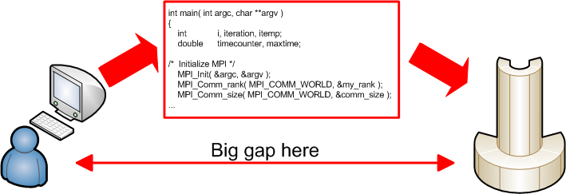
Why Are They Scale-dependent?
The gap between development and production environments makes applications vulnerable to such bugs
Developed and tested on small-scale desktops with mock inputs
Deployed in large-scale production systems to handle real user data
Notes:
In development phase, the program is developed on small-scale systems and tested with small-scale input
In deployment phase, users run the program on large-scale production systems and give petabytes of data as input
Problems with this practice
Developers may miss corner cases that happen only in large-scale runs
Small-scale test cases may not cover real user input in petascale
As a result, developers may miss bugs happening on large-scale runs

Slide 72
Why Not Test at Scale?
Lack of resources
User data is hard to get
Production systems are expensive
Difficult to debug
Large-scale runs generate large-scale logs
Might not have a correct run to compare with
New trend
Fault inject in production [Allspaw CACM 55(10)]

Slide 73
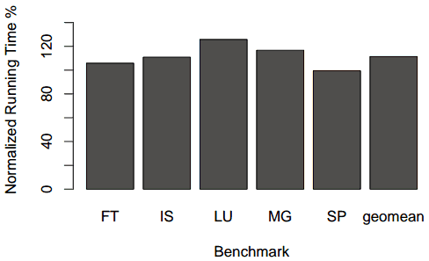
Overhead on NAS Parallel Benchmarks
Geometric Mean: 11.4%

Slide 74
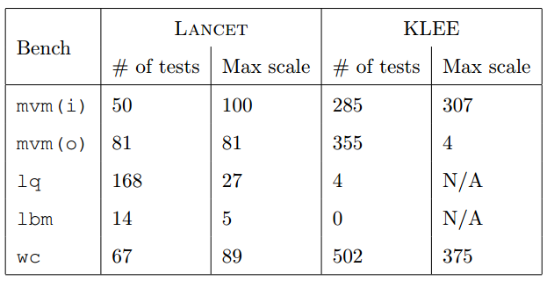
Explicit Mode versus KLEE
Benchmarks: libquantum, lbm, wc, mvm

