Slide 1

Failure Characterization and Error Detection in Distributed Web Applications
PhD Final Examination
Fahad A. Arshad
School of Electrical and Computer Engineering
Purdue University
April 23, 2014
Major Professor:
Prof. Saurabh Bagchi
Committee Members:
Prof. Arif Ghafoor Prof. Samuel Midkiff Prof. Charles Killian

Slide 2
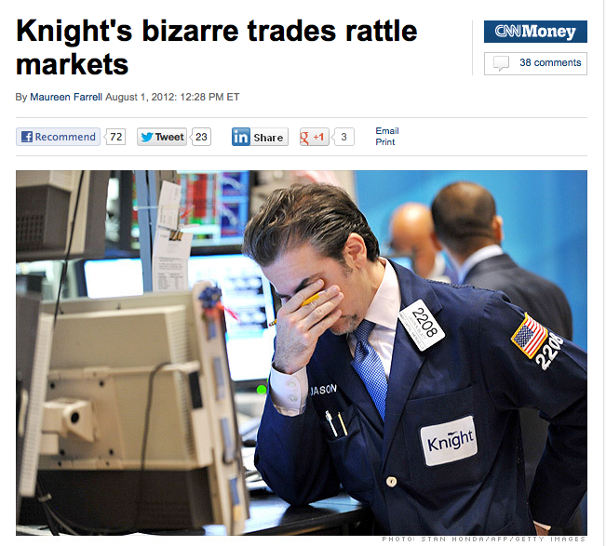

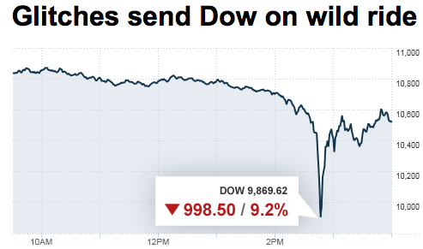
Lost $14 Million/min due to a Bug
“They made one obviously terrible mistake in bringing online a new program that they evidently didn’t test properly and that evidently blew up in their face.”
David Whitcomb, Founder of Automated Trading Desk
Source: CNN Money: Aug 1, 2012
Source: CNN Money: May 6, 2010
Dependability?
Notes:
A bug in the stock trading algorithm, where many stocks were traded erroneously caused a loss of 440M in 30 minutes.
Knight Capital Group said the problem was triggered when it installed new trading software, which resulted in the company sending numerous erroneous orders in 140 stocks listed in the New York Stock Exchange

Slide 3
Why do these Failures Occur?
Limited Testing
  Short delivery times
  High developer turnover rates
  Rapid evolving user needs
Environmental effects
  Operator mistakes
  Server overload
Non-deterministic effects
  Concurrency errors
Notes:
web applications have short delivery times, high developer turnover rates, and rapidly evolving user needs that translate into an enormous pressure to change

Slide 4
Dependability Aspects of Distributed Applications
Testing
and Characterization
Error Detection
Problem Localization
Failure Recovery
Programmer
Mistakes
SRDS-2011
Operator
Mistakes
ISSRE-2013
ConfGuage
Performance
Problems
ICAC-2014
Griffin
Performance
Problems
SRDS-2013
Orion
Prelim
Post-Prelim
Notes:
-Testing and characterization: Fault-injection & bug-repository-based study

Slide 5
Presentation Outline
CONFGUAGE – Characterization and Detection of Configuration Problems
GRIFFIN – Detection of Duplicate Requests for Performance Problems
ORION – Diagnosis of Performance Problems using Metrics
Motivation
Summary
Case Study
Algorithm Workflow
High-level Diagnosis Approach
Problem Statement
Java EE Server Overview
Failure Classification Methodology
Fault-Injector
Discussion
Motivation
Root Causes
Detection Algorithm
Evaluation
Summary

Slide 6
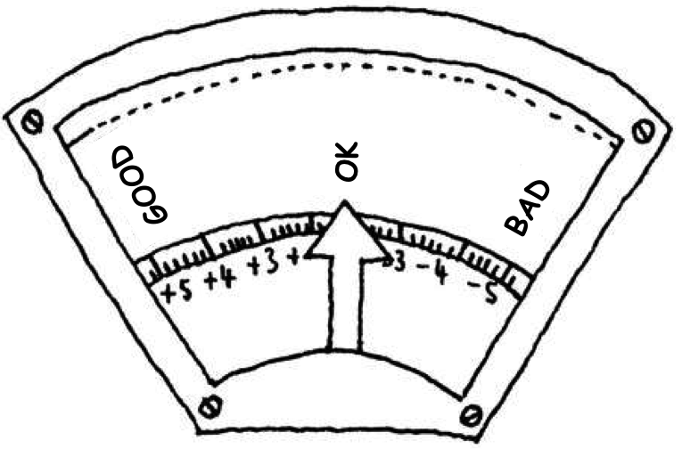
Characterizing Configuration Problems in Java EE
Application Servers: An Empirical Study with
GlassFish and JBoss
ConfGuage

Slide 7

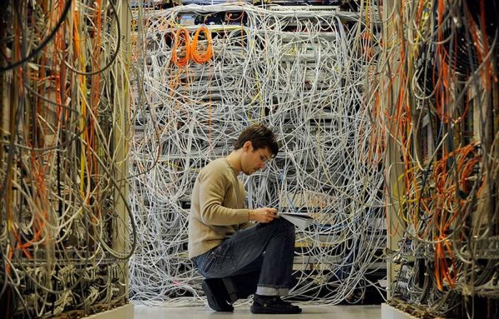

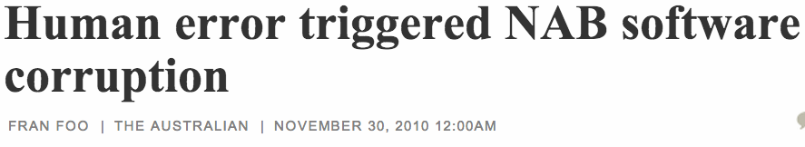


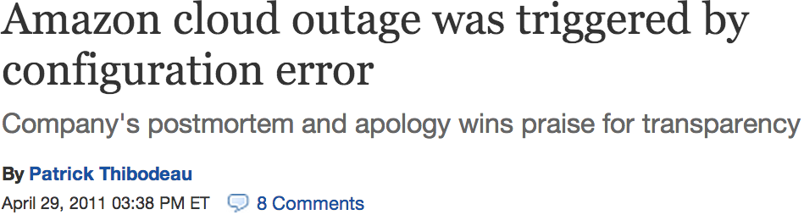

Motivation
Configuring computers is not easy
  Complexity
Configurations change
Finding root-cause of a configuration problem is harder
"Unfortunately (and here's the human error), the URL of '/' was mistakenly checked in as a value to the file and '/' expands to all URLs." -Marissa Mayer
Evaluating Configuration Robustness is Important
Notes:
Configuration is not an easy job
Configs change based on requirements
Google Glitch
"Unfortunately (and here's the human error), the URL of '/' was mistakenly checked in as a value to the file and '/' expands to all URLs." - See more at: http://www.eweek.com/c/a/Enterprise-Applications/Human-Error-Caused-Google-Glitch/#sthash.j8eropV2.dpuf
Recommendation: "We will carefully investigate this incident and put more robust file checks in place to prevent it from happening again," she wrote.
Impact:

Slide 8
Overview
What ?
  Characterized configuration problems in Java EE servers
  Fault Injector for configuration bugs
Why ?
  To improve the configuration resilience
How ?
  Analyzed bug-reports of Java EE servers (GlassFish, JBoss)
  Mutated parameters in configuration files
Key Result
  Bug Analysis: At least 1/3rd problems are configuration-related
  Fault Injector: Only 65% non-silent manifestations in GlassFish
Notes:
What?
What are common properties of config-problems.
Why?
- Once we have some insight into the characteristics, we can take steps to increase the the capacity to recover quickly from these problems.
How?
- Bug reports

Slide 9
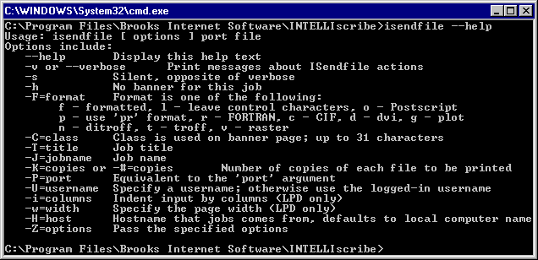

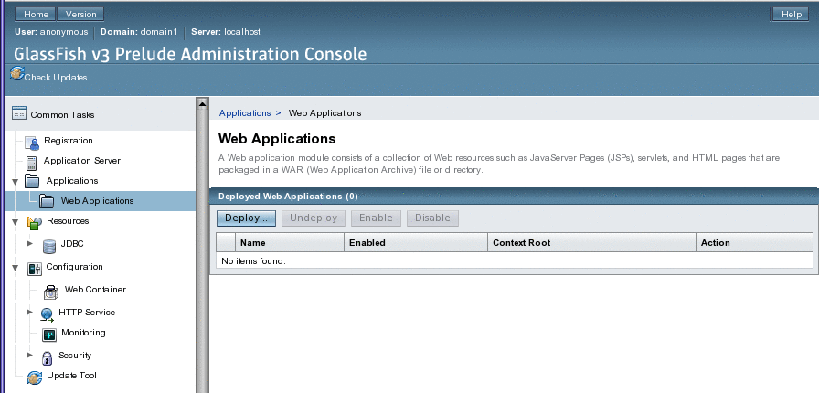
Java EE Server Overview
App A
App B
Java EE Server
Deployment
Module
CLI
JDBC
Connector
DB
Admin
Resources
Web Browser Admin GUI
JVM
Notes:
A Java EE application server provides tools and APIs to develop multi-tier enterprise applications. It is designed to implement several Java EE standards represented by Java Specification Requests (JSRs)
- The arrow-heads in Figure point to server components that require configuration data from outside. At boot-time, JVM parameter configurations are configured for a Java EE server.
- At run-time, an administrator can create server resources such as JDBC resources (connection pools), JMS (Java Messaging Service) resources, etc. These resources provide applications with a way to connect to other components, JDBC for database or JMS for asynchronous services (e.g., mail services). The creation and destruction of these resources, a configuration task requiring configuration parameters, is executed either by using the commmand-line interface or administration-console in the web browser.

Slide 10
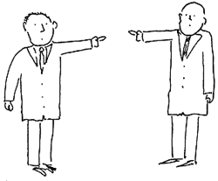
Classification of Configuration Problems
Type
Parameter-based
Time
Pre-boot
Responsibility
Developer
Manifestation
Silent
wrong parameter type, value, format
Compatibility
wrong library ver
Misplaced-Component
Boot-time
Run-time
Non-Silent
User
No server-log entry
Clear manifestation in server logs
JBAS-1115: “missing a "/" in
one spot and has a double slash "//" in another spot.”
Fix:
if(schemaLocation.charAt(0) !='/')
schemaLocation = '/'+schemaLocation;
GLASSFISH-18875: “EAR Deployment slow. Hangs during EJB Deployment.”
Fix: Removed a toString() method that was badly implemented and consumed all the time
After Fix: Deployment time reduced from 50 min to 2 min.
whose fault?
Notes:
Type
The first dimension (Type) considers a configuration-bug due to a problem relating to a particular parameter option, incompatibility with an external library or a missing component
Example: JBAS-1115
Compatibility
This is a problem that occurs due to an incompatibility with the environment.
JBAS-5275, where while reading xml-attribute values, the application server reads the values in different orders when run in different JVMs. The application server handles the values for attributes when read in forward direction, but fails to handle when read in backward direction for some JVMs
Misplaced-Component
A misplaced-component is a type of configuration problem which occurs when a component or a file is missing or in the wrong location and subsequently causes an application to fail.
Example: GLASSFISH-17462, where a missing file (ssl.json) manifests as a NullPointerException in server log, while the user is shown a HTTP 404 error screen in administration console.
Developer: A configuration bug that is fixed by a code change made by the developer.
User: A bug that is fixed by making the appropriate change in the configuration file, menu. etc.
- Manifestation
Silent: A silent error can occur as a performance problem, data-corruption or a problem that is not directly detectable by the operator (e.g., network administrator) and is not manifested as a relevant exception in the server logs.
Non-Silent: Clear manifestation, typically as exceptions in the server logs

Slide 11
Bug-report Characteristics
Study-1
  Sampling-based (124 bugs)
  Longer-span (multi-vers)
Study-2
  Keyword-based (157 bugs)
  Shorter-span (specific-vers)
Server |  | #Bugs | Time Interval | Versions
GlassFish (GF) | Study-1 | 101 | May, 2005 – Mar, 2012 | Beginning till ver 4.0
 | Study-2 | 132 | Aug, 2011 – Jul, 2012 | 3.1.2
JBoss (JB) | Study-1 | 23 | Apr, 2001 – Mar, 2012 | Vers 3, 4, 5, 6
 | Study-2 | 25 | Nov, 2010 – Sep, 2012 | Ver 7
Keywords Help
Study-1
Study-2
Notes:
- We only looked at bugs that have been Fixed. (a total of 281 Bugs analyzed)
Study-1 (longer time-period):
- Sampling-based (uniformly sample 1%)
- More than 1/3rd are configuration-problems
Study-2 (shorter time-period):
Keyword-based filter
More focus on config-bugs on specific vers of GF, JB

Slide 12
Results: Type and Time Dimensions
Study-1 (Sampling based): Inter-Ver
Study-2 (Keyword based): Intra-Ver
GlassFish
JBoss
Notes:
Study-1
This is a break-up of all the configuration problems
GF: we observe a majority of the problems (79%) relate to configuration parameters and occur at run-time.
JB: Almost equal-share of parameter/miss-component. We suspect that the 50% share of miss-components can be due to the changes made to configuration-interface
Study-2
Within(intra) version properties over a shorter period (More configuration bugs since keyword based)
GF: Lesser parameter-problems (primarily due to the fact that names, values and format are more likely to change across versions (as opposed to within versions)). Run-time problems have a major-share. Similar pattern for manifestation and responsibility dimensions
JB: Almost equal share of each sub-type. More compatibility problems (10% to 36% from study-1 to study-2), primarily due to the refactoring done from jboss-6 to jboss-7. The refactoring was big-enough to require a migration guide. More runtime-problems (20% to 69% from study-1 to study-2) which can also be attributed to major code-refactoring.

Slide 13
Common Patterns Learned
Parameter-based problems occur in majority
  Inter-version: majorly parameter-related
  Intra-version: almost equal-share of parameter, compatibility, miss-component
Majority of configuration problems show-up at runtime
  Directly affect users as the system is serving end-customers
Majority of manifestations are non-silent
  Need to make the silent problems non-silent
Developers have a greater responsibility
  Development of robust configuration-interface
Notes:
Inter-version problems are majorly parameter related, thus requiring more consistency in configuration-design from version-to-version.
Intra-version configuration-problems have an almost equal share for each of parameter, compatibility, missing-component subtypes.

Slide 14
Outline
Java EE Server Overview
Classification Methodology
Fault-Injector
Discussion

Slide 15
ConfGuage: Fault-Injector
Inject while emulating normal server-management workflow
Mutate a parameter in XML file
Start Application Server
Deploy
Web
Application
Stop
Application
Server
Run
Workload

Slide 16
ConfGuage: Fault-Injector
What to inject ?
  Parameter-based single-character at a time, e.g., “/”, “ ”
Where to inject ?
  GlassFish, JBoss, SPECjEnterprise2010
  XML attribute values in files (domain.xml, web.xml, persistence.xml)
When to inject ?
  Boot-time
How to inject ?
  Parse XML file
  Inject based on a mutation-operators (Add, Remove, Replace)
  Automate workflow(start, deploy, stop) using CARGO API
Notes:
What?
- This is motivated by what we found in several bug-reports
Where?
When?
- Boot-time here means either application-server start or application-deploy operation
How?

Slide 17
ConfGuage: Fault-Injector Mutation Example
Mutation Operator | Original Value | Mutated Value
Add | <servlet><servlet-name><jsp-file>/purchase.jsp</jsp-file></servlet-name></servlet> | <servlet><servlet-name><jsp-file>//purchase.jsp</jsp-file></servlet-name></servlet>
Remove | <jdbc-resource jndi-name="jdbc/__default" pool-name="DerbyPool"/> | <jdbc-resource jndi-name="jdbc__default" pool-name="DerbyPool"/>
Replace | <property name="URL" value="jdbc:mysql://hostname:3306/specdb"/> | <property name="URL" value=""/>
Notes:
For one injection, ConfGauge mutates one string in one of the xml files, starts the application server, deploys the SPECjEnterprise2010 application, stops the application server and collects the server logs for analyzing the effect of injection.

Slide 18
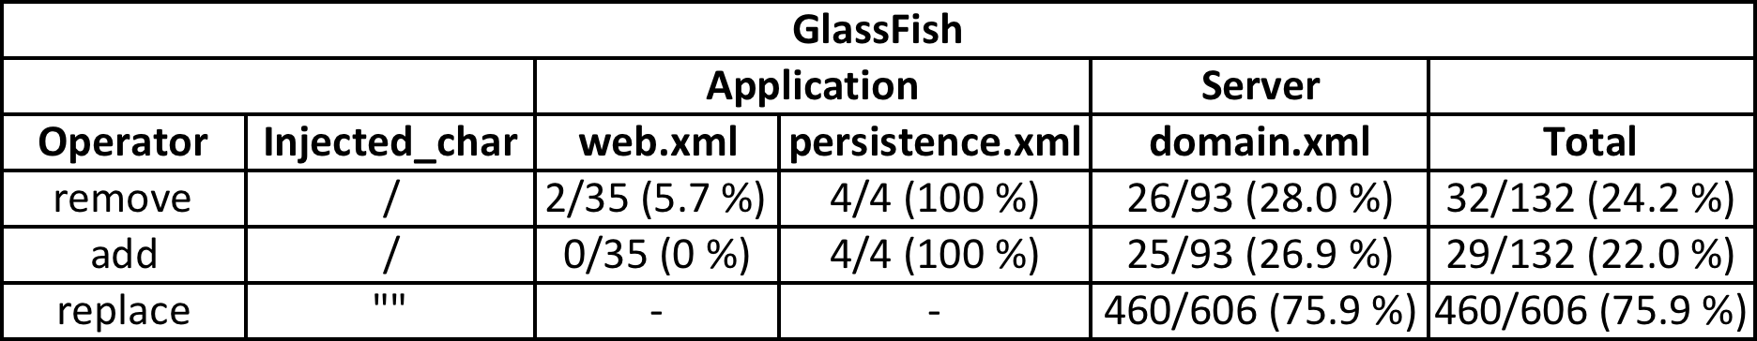
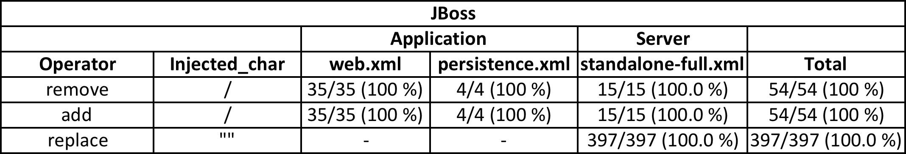
Fault-Injection Results: Non-silent manifestations
Not all servers have equal configuration robustness
Notes:
For a total of 132 injections of "/" character in GlassFish, both the server configurations in domain.xml and the application configurations in web.xml have silent failures for the majority of injections.
- For most of the injections (94.3% with remove and 100% with add operator) in web.xml, the server log did not show any exceptions at boot-time. This fact where exceptions are delayed until the end-user accesses the application through the web browser is a point of concern.
Why does the configuration robustness differ across servers?
No standards, so vendors are at liberty

Slide 19
Discussion
Observations
  Inter vs Intra version configuration problems have different characteristics
  Code-refactoring/re-implementation introduces compatibility problems
  To detect silent manifestations (GF:35%), more-intrusive checks are required
Recommendations
  Automating fixing of parameter-values
  Improving bug repository
    Duplicate-bug detection
    Cross-referencing with Fixes
Notes:
1) Inter-version and intra-version configuration problems tend to have different characteristics. Inter-version problems
are majorly parameter-related while intra-version problems have an almost equal share for each of parameter, compatibility and missing-component related issues.
2) Code refactoring or re-implementation results in an increased number of compatibility issues.
3) Silent configuration-related failures (35% in GlassFish) found by ConfGauge provide evidence of inadequate
configuration validation. Silent failures should be made non-silent via more intrusive validation checks.

Slide 20
CONFGUAGE Conclusion
Failure Characterization of Java EE Application Servers
  Four studied-dimensions: Type, Time, Manifestation, Culprit
Fault-Injection
  Parameter-based
  Boot-time
Lessons learned
  Configuration robustness varies from server-to-server
  Parameter-based issues occur most frequently and therefore require more attention

Slide 21

Detection of Duplicate Requests for Performance Problems
GRIFFIN

Slide 22

Motivation for Detecting Duplicated Requests
What is a duplicated request?
  A web-click resulting in the same HTTP request twice or more
Consequences
  Cause extra server load
  Corrupt server state
Frequency of Occurrence
  Top sites CNN, YouTube
  At-least 22 sites out of top 98 Alexa sites (Chrome)
  “I'd also like to give you some easy numbers to show the impact. www.yahoo.com has 300 million page views per day, which clearly requires a lot of machines. If that number were to double, is there any doubt that would lead to capacity issues?”
  Tech Lead yahoo.com
Notes:
A web-click resulting in the same HTTP request twice or more to server.
Comment from Nicholas Zakas “I'd also like to give you some easy numbers to show the impact. www.yahoo.com has 300 million page views per day, which clearly requires a lot of machines. If that number were to double, is there any doubt that would lead to capacity issues?”
Top sites CNN, YouTube
Unneeded extra server load can lead to managers in buying/provisioning more servers
Corruption of server state leads to incorrect data
Alexa sites with duplicate requests (tested on 04/12/2014, 04/19/2014): vube.com,paypal.com,go.com,hao123.com,conduit.com,espn.go.com,taobao.com,sohu.com,amazon.com,amazon.co.jp,pinterest.com,tmall.com,dailymotion.com,msn.com,amazon.de,cnn.com,163.com,dailymail.co.uk,yahoo.co.jp,ifeng.com,qq.com,huffingtonpost.com

Slide 23
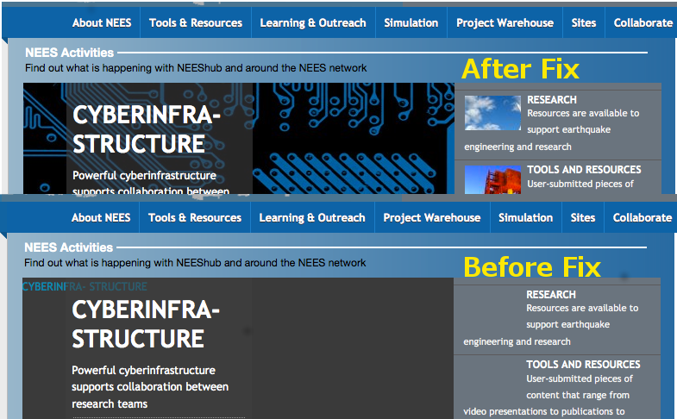
Root Causes of Duplicated Web Requests
Missing resource cause
Manifestation in
browser
@@ -18,8 +18,8 @@ defined('_JEXEC') or die('Restricted access');
1 <?php foreach($slides as $slide): ?>
2 <div class="slide">
3 <a<?php echo $slide->target; ?> href="<?php echo $slide->link; ?>" class="slide-link">
4 - <span style="background:url(<?php echo $slide->mainImage; ?>) no-repeat;">
5 - <img src="<?php echo $slide->mainImage; ?>" alt="<?php echo $slide->altTitle; ?>" />
6 + <span style="background:url(media/system/images/cc_button.jpg) no-repeat;">
7 + <img src="media/system/images/cc_button.jpg" alt="<?php echo $slide->altTitle; ?>" />
8 </span>
9 </a>
10
@@ -59,7 +59,7 @@ defined('_JEXEC') or die('Restricted access');
11 <?php foreach($slides as $key => $slide): ?>
12 <li class="navigation-button">
13 <a href="<?php echo $slide->link; ?>" title="<?php echo $slide->altTitle; ?>">
14 - <span class="navigation-thumbnail" style="background:url(<?php echo $slide->thumbnailImage; ?>) no-repeat;">&nbsp;</span>
15 + <span class="navigation-thumbnail"style="background:url(media/system/images/cc_button.jpg) no-repeat;">&nbsp;</span>
16 <span class="navigation-info">
17 <?php if($slide->params->get('title')): ?>
28 <span class="navigation-title"><?php echo $slide->title; ?></span>
1 Var img = new Image();
2 img.src = “” //Code resolving to empty

Slide 24
Root Causes of Duplicated Web Requests
Duplicate Script Cause
Manifestation in Browser
  None
1 <script src="B.js"></script>
2 <script src="B.js"></script>

Slide 25
Problem Statement and Design Goals
How to automatically detect duplicated web-requests ?
Design goals
  Low overhead
  Low false-positive
  High detection accuracy
  General purpose solution
  Scope for diagnosis
Notes:
Resource exhaustion/leaks type of performance problems.
General Purpose means that it applies to all browsers and all resources

Slide 26
Griffin’s High-level Detection Scheme
Trace Synchronously
1
Extract Function-Call Depth Signal
2
Compute Autocorrelation and Detect on Threshold
3
Notes:
Trace Synchronously by Dynamic instrumentation
1-2-3-2-1-2-1-2-1-0

Slide 27
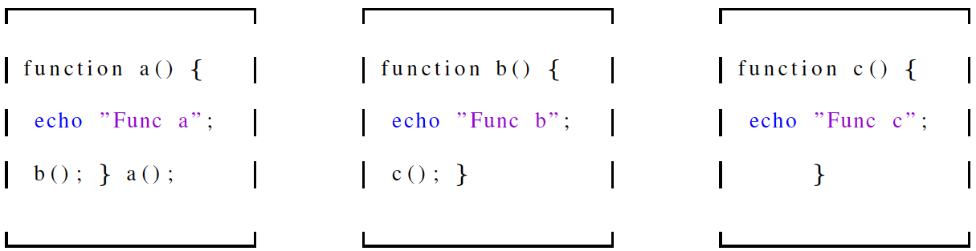
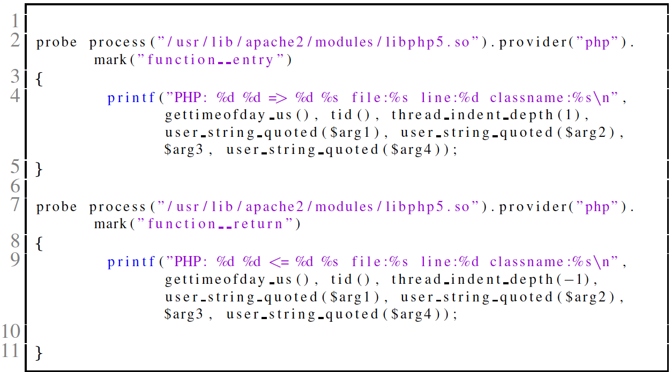
Synchronous Function Tracing with Systemtap
abc.php where a() calls b() and b() calls c()
Entry
Probe
Which
event to
Trace?
What to
print?
Return
Probe
php.stp
Notes:
Example

Slide 28
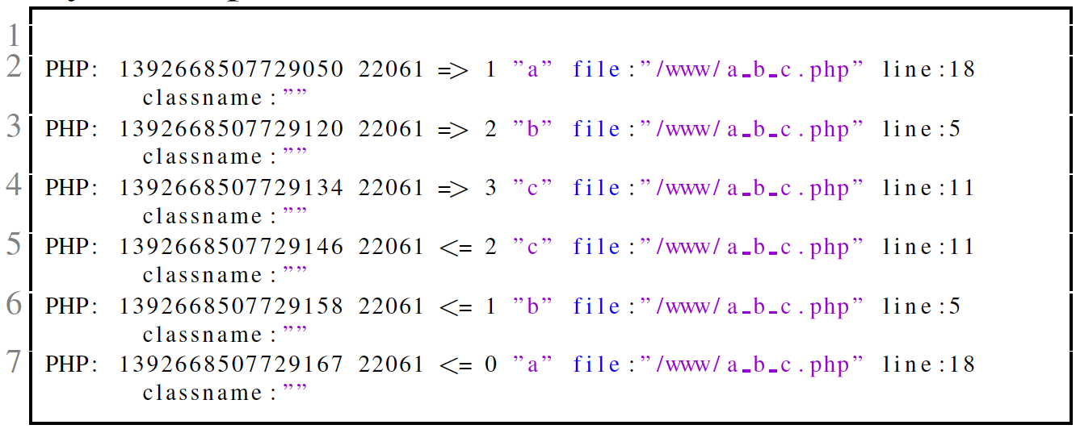
OUTPUT: Synchronous Tracing with Systemtap
entry/
exit
function
name
Line
number
timestamp
tid
call-depth
filename
php.stp.output

Slide 29
Function-call-depth to Autocorrelation Example
3
2
2
2
2
1
1
1
1
0
1
2
3
4
5
6
7
8
9
10
Autocorrelation => shift + multiply + sum
C₀=1x1+2x2+…+1x1+0x0=28 R₀=C₀/C₀=1
C₁=1x2+2x3+…+2x1+1x2=24 R₁=C₁/C₀=0.85
C₁₀=1x0+2x0+…+2x0+1x0=0 R₁₀=0/C₀=0.0
Notes:
1-2-3-2-1-2-1-2-1-0
Autocorrelation=shitf+multiply+sum

Slide 30
Autocorrelation Example with Duplicate requests
3
3
Repeated signal due to duplicate request
2
2
2
2
2
2
2
2
1
1
1
1
1
1
1
1
0
0
C₀=1x1+2x2+…+1x1+0x0=56 R₀=C₀/C₀=1
C₁₀=1x1+2x2+…+1x1+0x0=28 R₁₀=C₁₀/C₀=0.5
C₂₀=1x0+2x0+…+2x0+1x0=0 R₂₀=0/C₀=0.0
Notes:
1-2-3-2-1-2-1-2-1-0

Slide 31
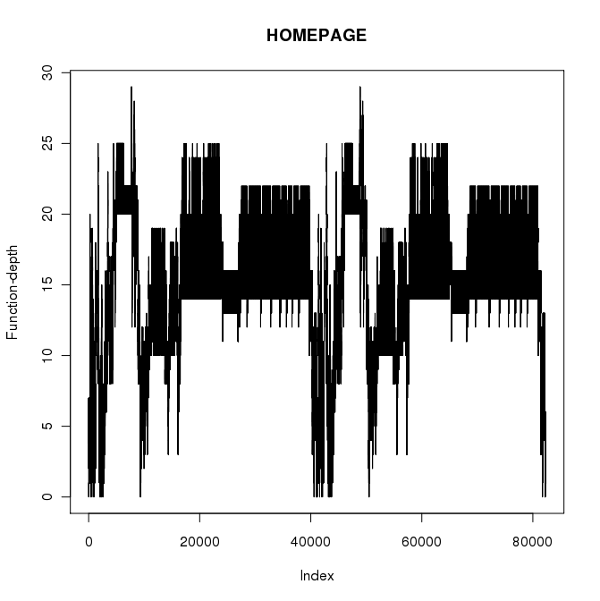
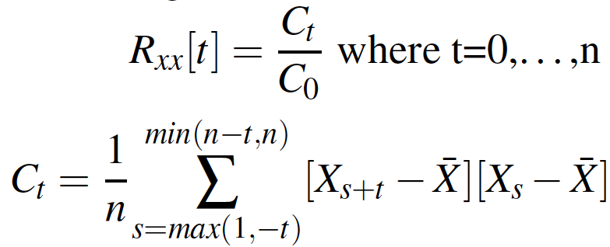
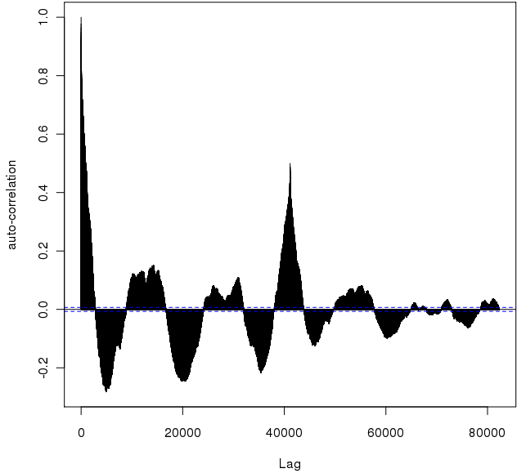
Detection Algorithm Example in NEEShub
Homepage
Signal
R_{xx}[0]=C₀/C₀=1
R_{xx}[40000]=C₄₀₀₀₀/C₀=0.49
Duplicate
Detected
Threshold
t₀
Notes:
Why is this algorithm better then other possible algos?
We just need to configure one parameter, i.e, threshold as oppose to maintaining multiple threshold params for each web request

Slide 32
Griffin’s Roadmap
  Motivation
  Root Causes
  Detection Algorithm
  Evaluation
  Summary

Slide 33
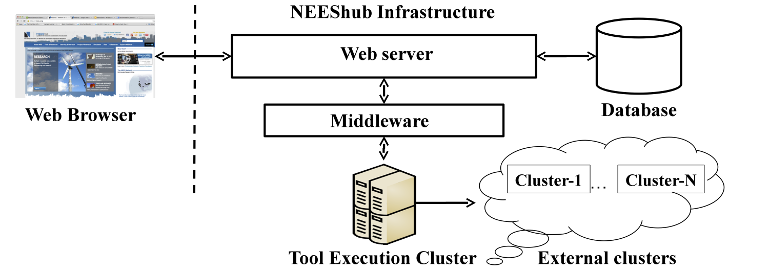
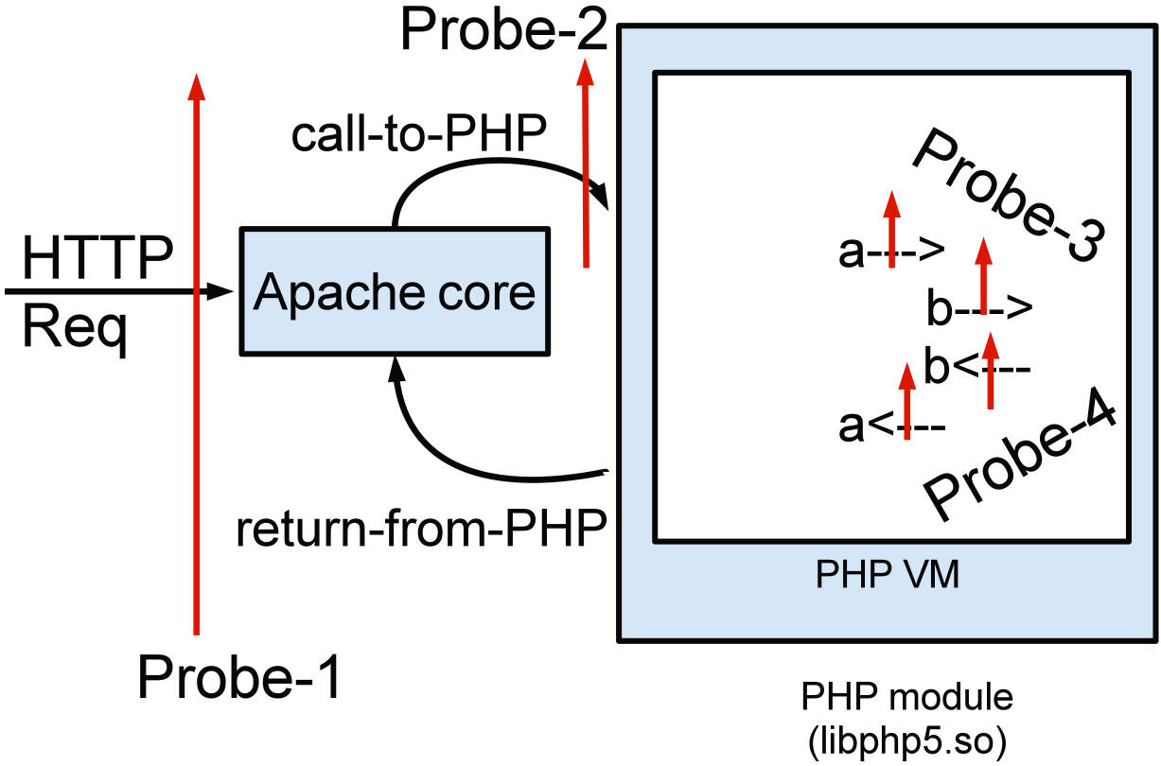
NEEShub: Target Evaluation Infrastructure
HUBZERO: Infrastructure for building dynamic websites
Probe
Architecture
Notes:
Instance of HUBZERO
- Over 30 hubs built using HUBZERO

Slide 34
Evaluation Metrics
Accuracy
Precision
Overhead
  Percentage Tracing Overhead
  Detection Latency (seconds)
Notes:
Detection is asynchronous

Slide 35
Definitions
Web-request
  GET, POST
Web-click
  mouse clicks generating multiple web-requests
  Homepage, Login, LoggingIn
Http-transaction
  Multiple web-clicks by a human user
  Homepage➔Login➔LoggingIn (size=3)
  Homepage➔Register (size=2)
GET, GET, GET
web-request
GET, GET, GET
web-request
http-transaction
web-click
web-click

Slide 36
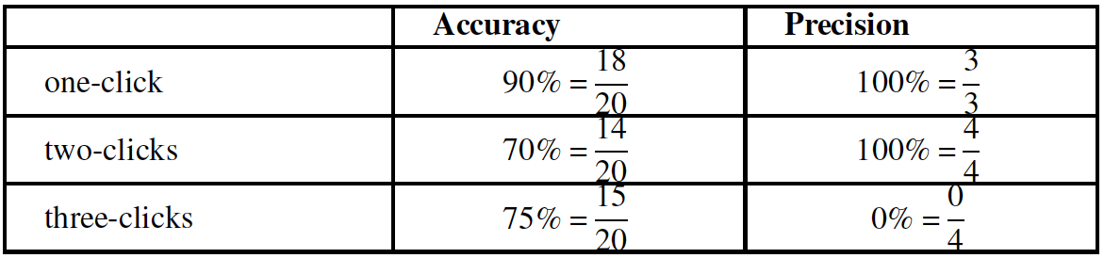
Detection Results
Tested 60 unique http-transactions
  20 http-transactions of size 1,2,3
Ground-truth established by manual testing from browser
  Duplicate requests found in seven unique web-clicks

Slide 37
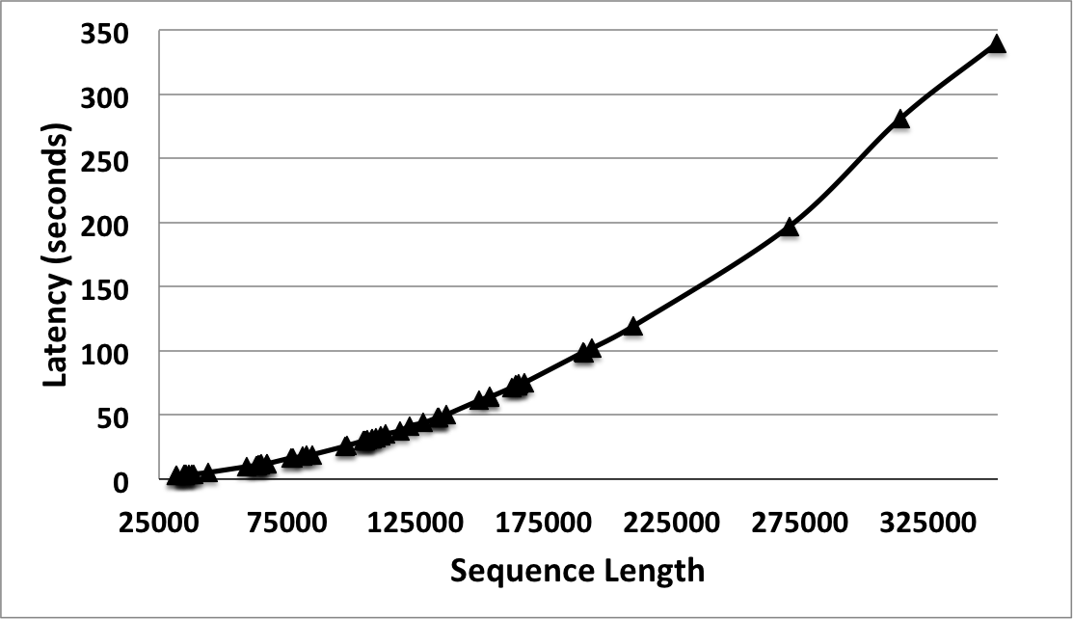
Overhead Results
Tracing Overheard
  1.29X
Detection Latency
Notes:
- 100K , about half a minute

Slide 38
Sensitivity to Threshold
one-click
three-click

Slide 39
Post-detection Diagnostic Context
Duplicate
Detected
Threshold
t₀
# TYPE: TIMESTAMP CALL/RETURN FUNC-DEPTH FUNC-NAME FILE LINE CLASS(if available)
39948 PHP: 1392896587135822 <= 15 "toString" file:"/www/neeshub/libraries/joomla/utilities/simplexml.php" line:650 classname:"JSimpleXMLElement"
39949 PHP: 1392896587135827 <= 14 "toString" file:"/www/neeshub/libraries/joomla/utilities/simplexml.php" line:650 classname:"JSimpleXMLElement"
.
.
.
41035 PHP: 1392896587178625 <= 0 "close" file:"/www/neeshub/libraries/joomla/session/session.php" line:160 classname:"JSession"
41036 APACHE: "/modules/mod_fpss/tmpl/Movies/css/template.css.php?width=…"
Problem Fix File: modules/mod_fpss/tmpl/Movies/default.php
To Developer: Look at “/modules/mod_fpss”
Notes:
- This could be dependent on the joomla namespacing

Slide 40
GRIFFIN’S Summary
General solution for duplicate detection using autocorrelation
  Trace function calls and returns
  Extract function call-depth signal
  Autocorrelation-based detection using only one threshold (0.4)
Zero-false positives with 78% accuracy
Low-overhead of tracing and detection

Slide 41

Diagnosis of Performance Problems using Metrics
Orion

Slide 42
Problem Statement
How to automatically localize problems ?
  Problem Types
    Performance problems
    Software-bugs
  Non-intrusive monitoring
  Scalability
Notes:
- Resource exhaustion/leaks type of performance problems.

Slide 43


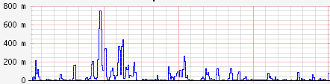
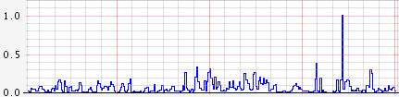


High-level Diagnosis Approach
Healthy
UnHealthy

Slide 44
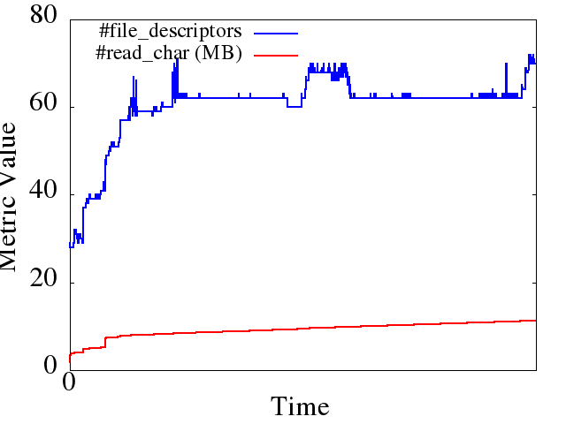
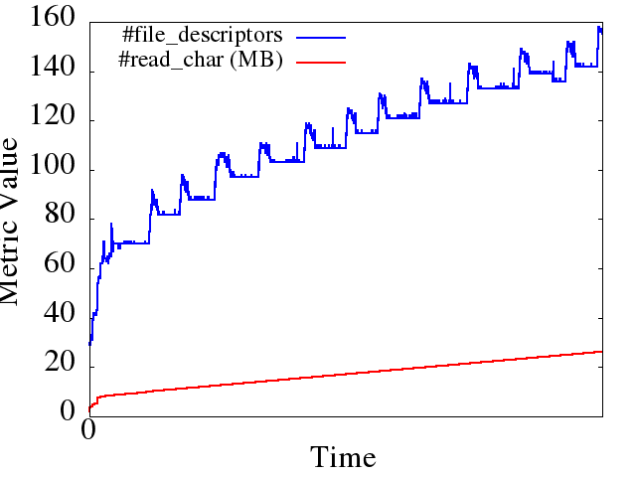
Observation: Bugs Change Metric Behavior
Healthy Run
Unhealthy Run
Patch
} catch (IOException e) {
ioe = e;
LOG.warn("Failed to connect to " +
targetAddr + "...");
+ } finally {
+ IOUtils.closeStream(reader);
+ IOUtils.closeSocket(dn);
+ dn = null;
+ }
Behavior is different
Hadoop DFS file-descriptor leak in version 0.17
Correlations differ on bug manifestation
Notes:
Correlation coefficient computed for abnormal run is 0.97 over the entire time window for the above two metrics.
Correlation coefficient computed for normal run is 0.85 over the entire time window for the above two metrics.
Metrics: open file descriptors, characters read from disk

Slide 45
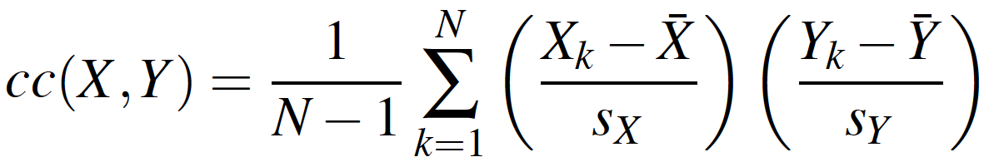
Compute Correlation Coefficients
Definition
Correlations vary
Pair-wise CCs
Healthy Run
Unhealthy Run
CCV = [cc_{1,2}, cc_{1,3},…, cc_{n-1,n}]
Dim(d) = P(P-1)/2

Slide 46
Overview of ORION workflow
Normal Run
Failed Run
When correlation model of metrics broke
Find Abnormal Windows
Those that contributed most to the model breaking
Find Abnormal Metrics
Instrumentation in code used to map metric values to code regions
Find Abnormal Code Regions

Slide 47
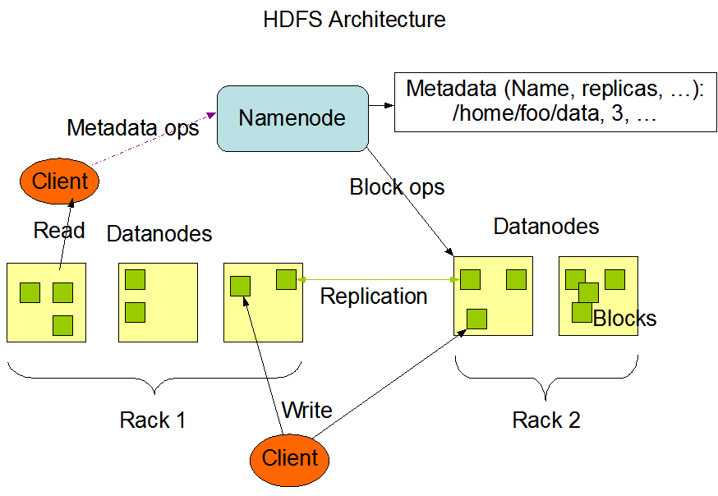
Case Study: Hadoop DFS
Notes:
- It enables applications to work with thousands of computational nodes and a large amount of data

Slide 48
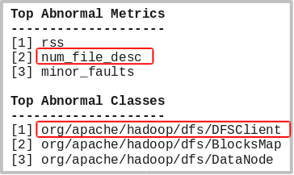
Case Study: Hadoop DFS Results
File-descriptor leak bug
  Sockets left open in the DFSClient Java class (bug-report:HADOOP-3067)
  45 classes, 358 methods instrumented
Output of the Tool
2nd metric correlates with origin of the problem
Java class of the bug site is correctly identified
Notes:
- 45 classes, 358 methods instrumented (as code regions)

Slide 49
ORION’s Conclusion
ORION – a tool for root cause analysis using metric-profiling.
Pinpoints the metric that is highly affected by a failure and highlights corresponding code regions.
ORION models application behavior through pairwise correlation of multiple metrics
Our case studies with different applications show the effectiveness of the tool in detecting real world bugs

Slide 50
Related Work
Error Detection
- C. Killian (Pip, NSDI’06)
L. Silva (NCA’08)
D. Yuan (ATC’11)
E. Kiciman (Neural Net’05)
Failure Characterization
Tracing Systems
D. Controneo (ICDCS’06)
Z. Yin (SOSP’11)
M. Vieira, (DSN ’07)
J. Li (QSIC’07)
W. Gu (DSN’03)
B. Cantrill (Dtrace, ATC’04)
R. Fonseca (X-Trace, NSDI’07)
B. Sigelman (Dapper, Google research 10)
C. Luk (Pin, PLDI’05)
Performance Diagnosis with Metrics
K. Ozonat (DSN’08)
I. Cohen (OSDI’04)
P. Bodik (EuroSys’10)
K. Nagaraj (NSDI’12)
Notes:
There’s log and metric analysis techniques that share the same goal that my techniques. The main problem is that not all the failures manifest in the system logs and application logs. Also scalability is an issue. There is a large amount of logs that have to be analyzed.
Failure Characterization:
- M. Vieira, (DSN ’07)=Assessing Robustness of Web-Services Infrastructures.
- J. Li (QSIC’07)= Study on non-configuration problems in J2EE app servers
Error Detection:
L. Silva Comparing Error Detection Techniques for Web Applications: An Experimental Study
E. Kiciman, Detecting application-level failures in component-based Internet services.
D. Yuan (ATC’11)–a tool that automatically detects software conﬁguration errors
Tracing system:
- X-trace: X-Trace, a cross-layer, cross-application tracing framework designed to reconstruct the user's task tree. This framework enables X-Trace enabled nodes to encode causal connections necessary for rebuilding this tree.
Logs and metric analysis:
M. Ozonat: An information-theoretic approach to detecting performance anomalies and changes for large-scale distributed web services.
Correlating instrumentation data to system states: A building block for automated diagnosis and control", Operating System Design and Implementation (OSDI 2004)[I. Cohen (OSDI’04)]
K. Nagaraj (NSDI’12): DISTALYZER, an automated tool to support developer investigation of performance issues in distributed systems.

Slide 51
Summary of Contributions
Study Bug Databases to understand Configuration Problems
Build Configuration Fault-Injector
Observe Reaction of Injection in Logs
Provide Robustness Insight
Characterize
Misconfigs
ISSRE-13
Build Monitoring Infrastructure
Execute
Autocorrelation
Flag based on
Threshold
Duplicate
Detection
ICAC-14
Instrument Application for Metric Collection
Build Normal Behavior Model
Find Suspicious
Metrics
Find Code Region Corresponding to Suspicious Metrics
Diagnosis
SRDS-13
Notes:
Third phase of Detection: Implement App-specific and App-Generic Rules based on deviation from Normal behavior.

Slide 52
Conclusions
Failure characterization
  Understanding how failures happen
  Insights in providing reliability to web applications
Error detection
  Application specific and generic rules
  Both synchronous and asynchronous detection algorithms improve reliability
  Detection of silent manifestations to unearth hidden problems
Automated failure diagnosis
  Code-regions where bugs manifest as failures assist debuggers
  Collecting metrics synchronously gives better accuracy

Slide 53
Credits
Major Advisor
  Prof. Saurabh Bagchi
Committee:
  Prof. Arif Ghafoor, Prof. Samuel Midkiff, Prof. Charles Killian
Collaborators:
  Ignacio Laguna, Amiya Maji, Subrata Mitra, Nawanol Theera-Ampornpunt
NEES Colleagues:
  Brian Rohler, Richard White, Gemez Marshall
Undergraduate Students:
  Sidharth Mudgal and Rebecca Krause

